Slide 2
ACTIVE RESTORATION OF MARINE HABITATS IN DENMARK
Federica Montesanto, Peter Stæhr and Karsten Dahl
Aarhus University - Ecoscience Department Danish Center for Marine Restoration
fmontesanto@ecos.au.dk

Slide 3
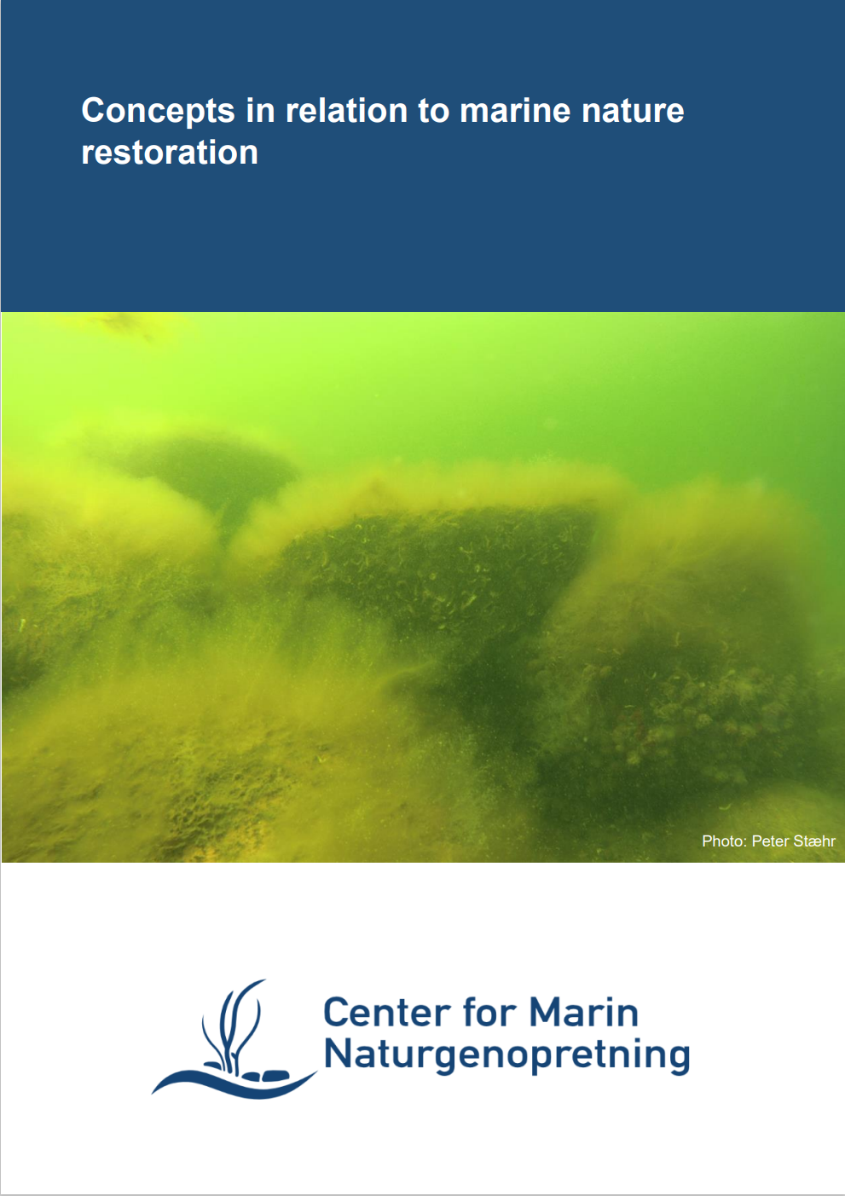
Definitions and common understanding
“Passive” restoration:
Ecosystem restoration using regulatory measures mitigating or removing pressures (Key element in managing WFD and MSFD)
“Active” restoration:
Changes in habitats/biotopes and species that are not reversible or not reversible in an acceptable timespan call for active restoration measures
Implicit in our understanding of active habitat and species restoration:
Previous historic distribution is documented
Will be “in line” with the EU decided threshold values for the MSFD descriptor ”Benthic integrity”: ”No more that 2% of the broad scale habitat should be irreversibly lost”
-https://www.danishmarinerestoration.com/media/72519/concepts-in-relation-to-marine-nature-restoration-uk.pdfuk.pdf

Slide 4
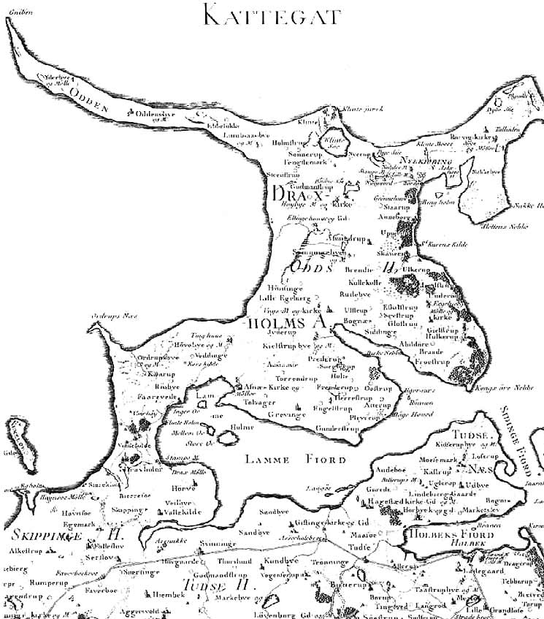
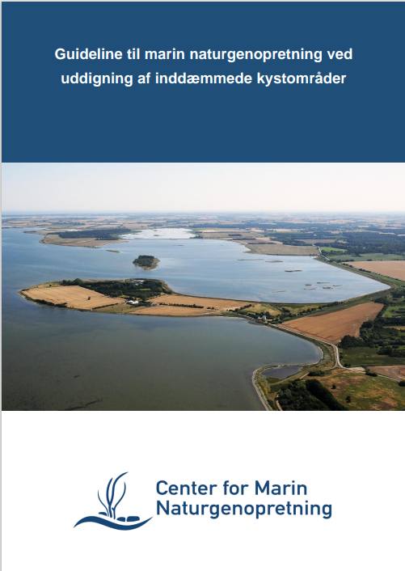
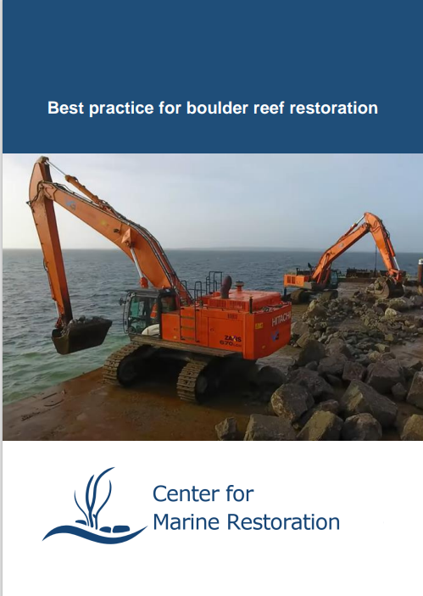
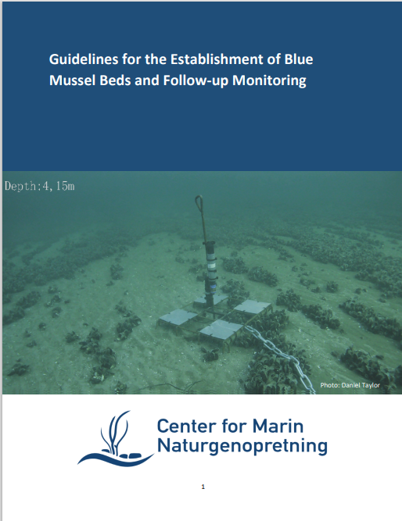
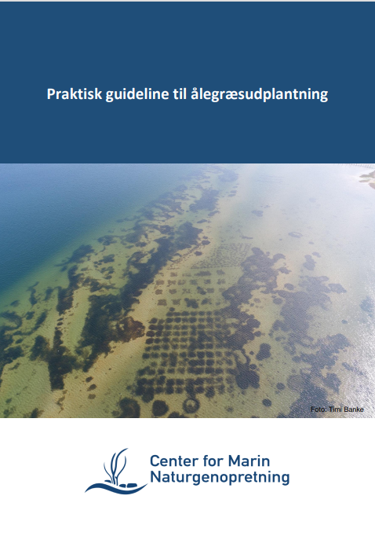
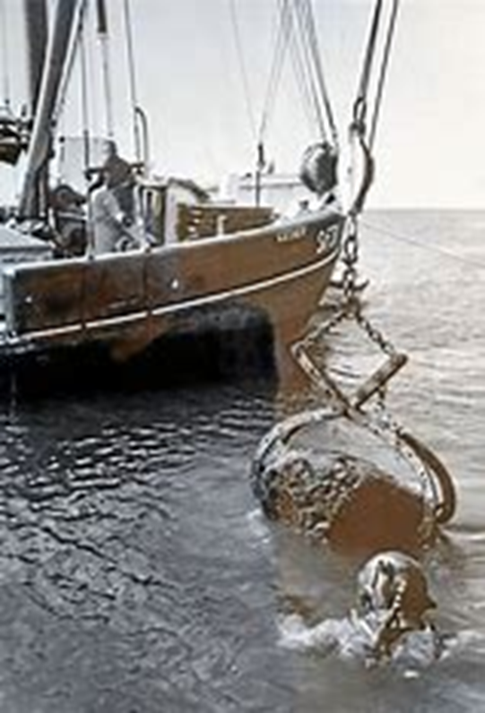
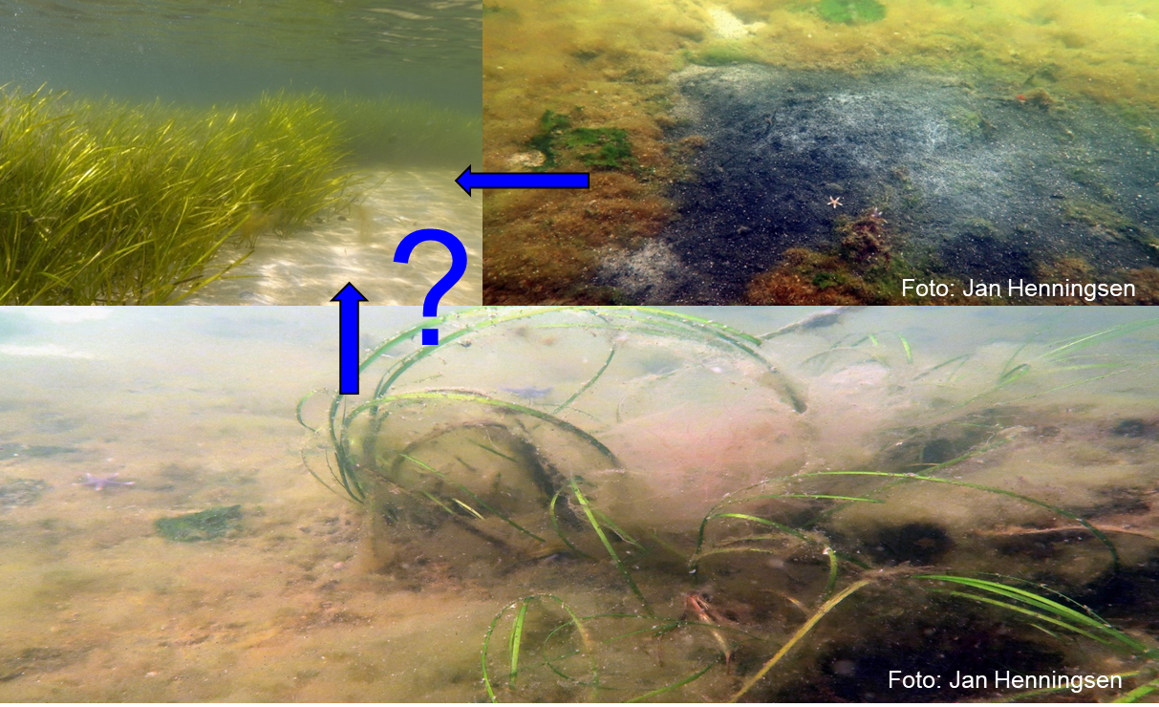
Habitats that call for active restoration efforts in DK
Fjords and shallow inlets lost by land reclamation
Boulder reefs from 0-10 meters depth (building material for harbours and other marine construction)
Biogenic reefs (targeted ore collateral damage by fishery)
Eelgrass beds (eutrophication, physical damage)
57Km²
Habitat | Loss (km²)
Fjords and inlets | 400
Boulder reefs | 55
Biogenic reefs | profound
Eelgrass beds | 4500

Slide 5
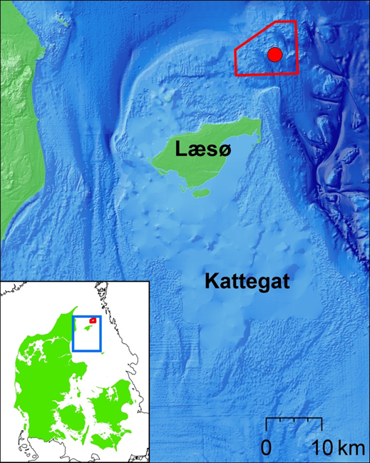
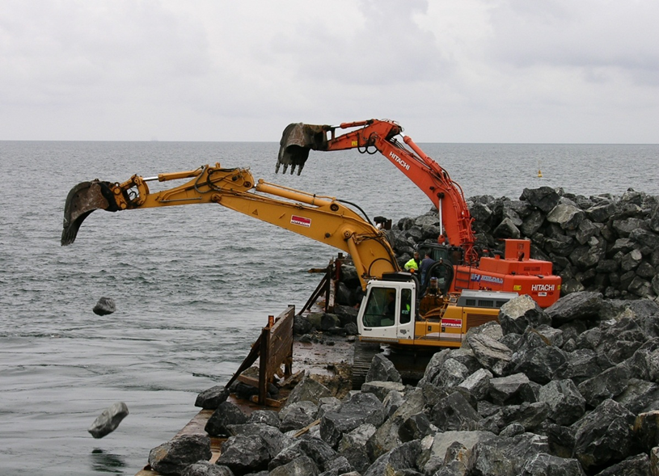
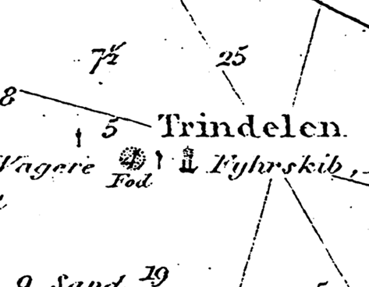
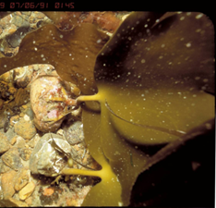
Restoration of Læsø trindel First funded marine EU LIFE project - year 2007-2012
Project title: Blue reef project
Baseline study: 2007 + Effect study: 2012
(Fish - fauna and vegetation - harbour porpoises)
Restored using app. 100.000 tons query boulders
Location
Reason: degrading Natura 2000 reef site

Slide 6
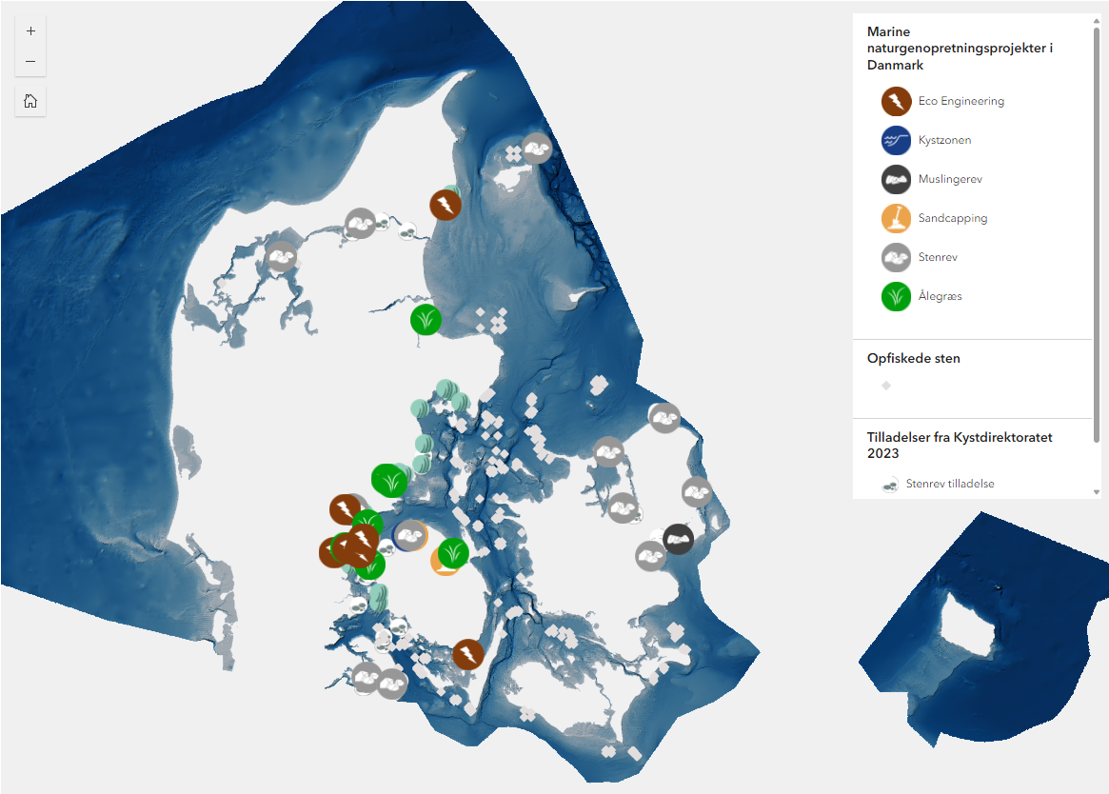
Experiences with marine restoration in Denmark
Major activities in DK:
Boulder reef restoration
Biogenic reef restoration
Eelgrass translplantation
Sandcapping
Coastal realignement
Danish Projects and applications available on:
Kort - Center for Marin Naturgenopretning
https://marinnatur.dk/

Slide 7
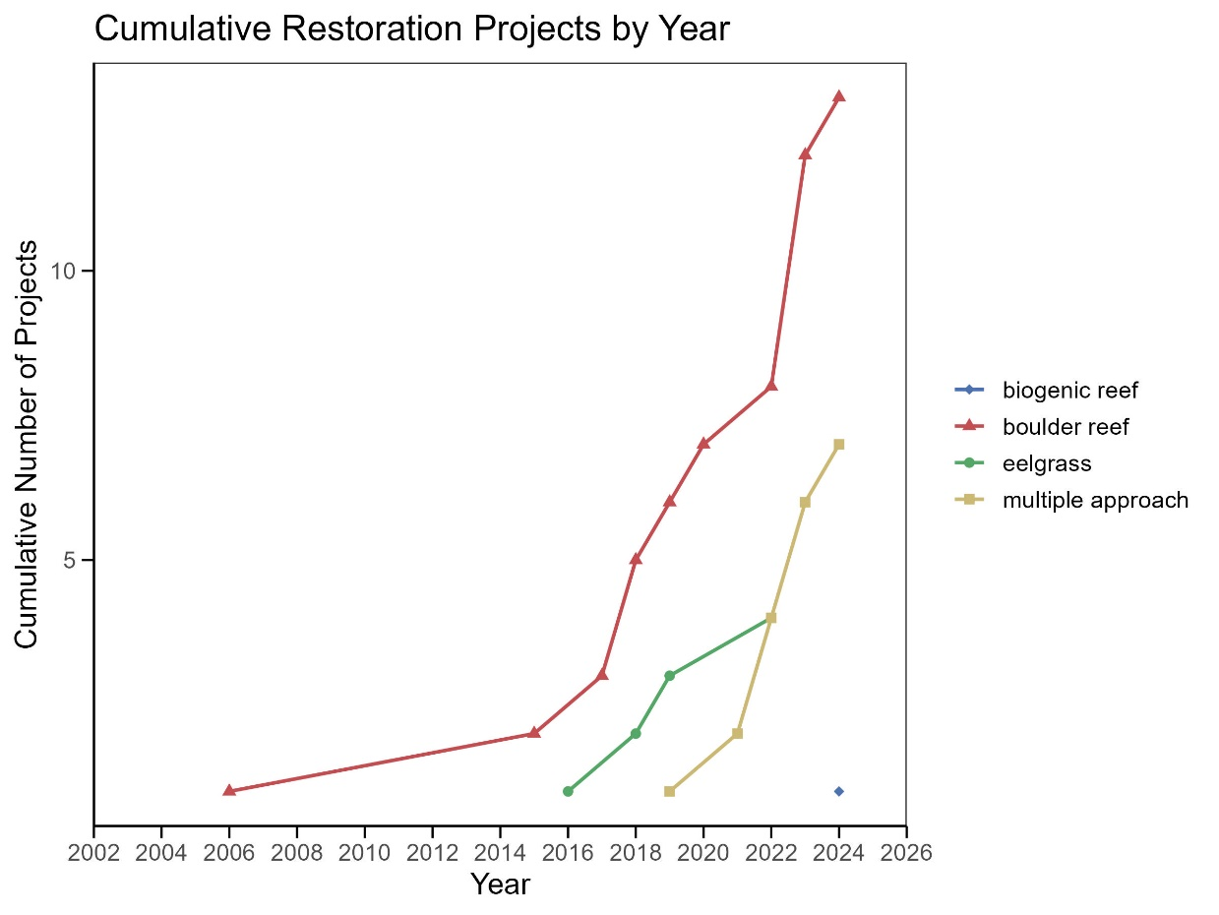
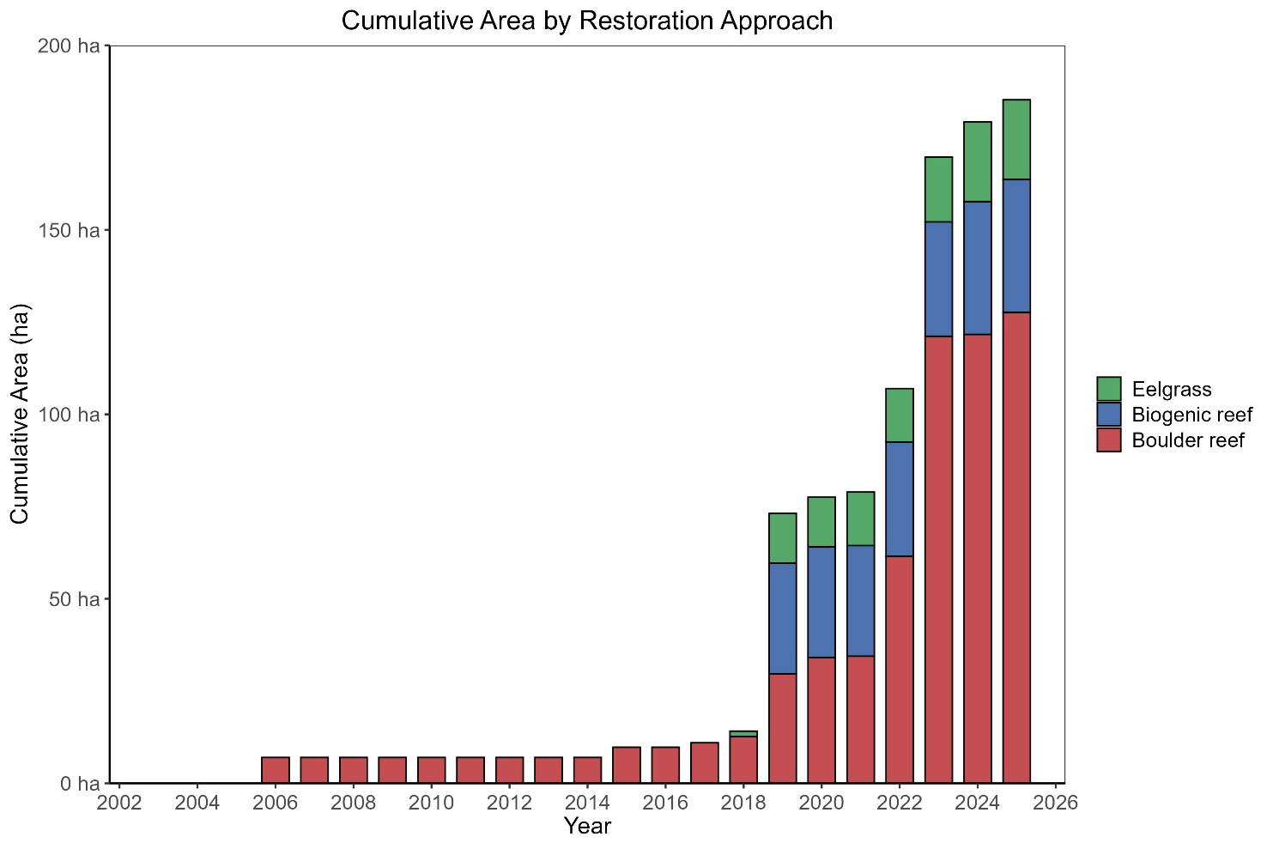
Experiences with marine restoration in dk
From single habitat restoration → large sea scape restoration

Slide 8
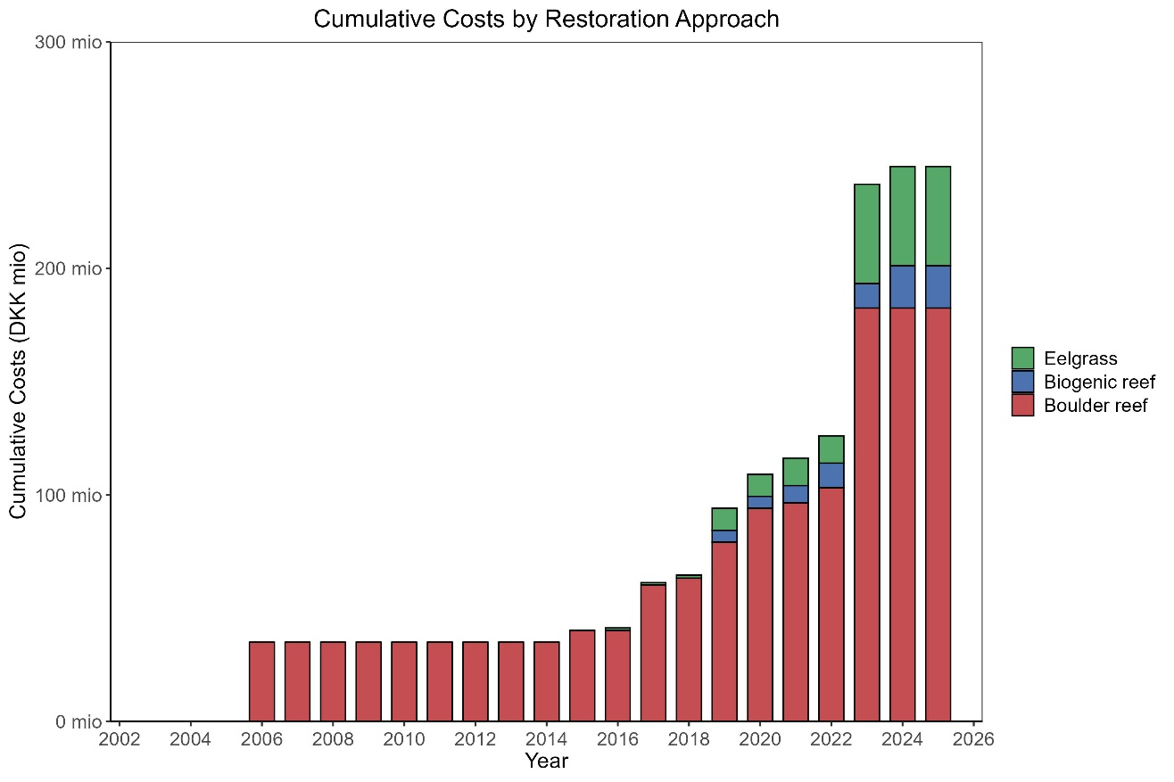
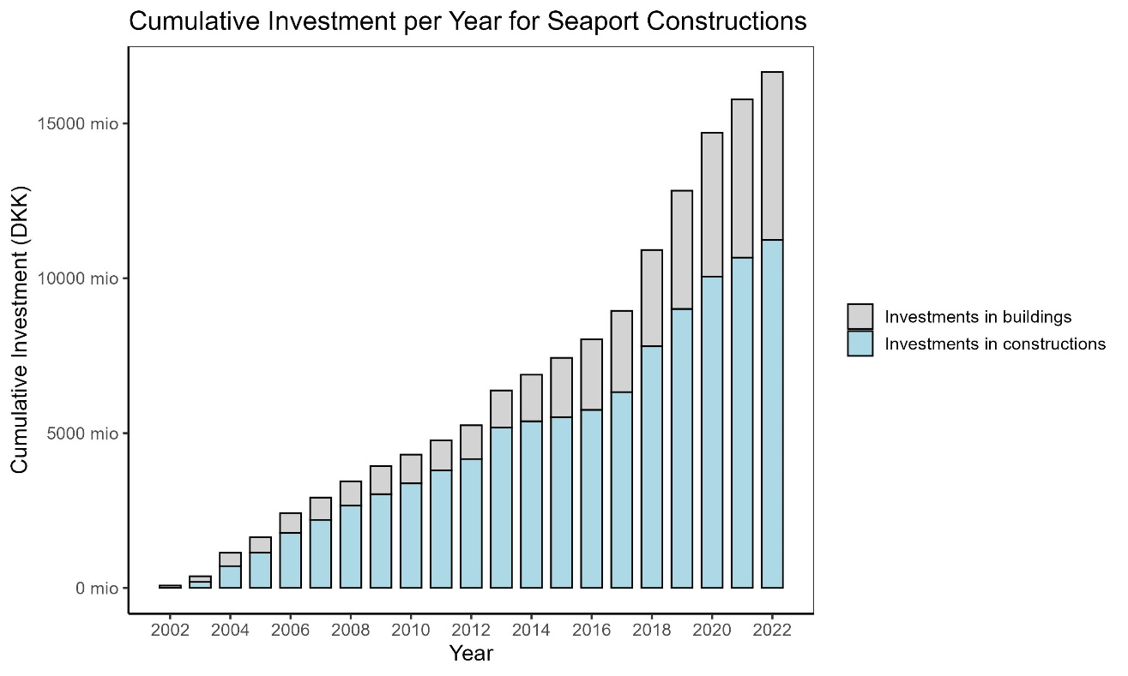
Experiences with marine restoration in dk
~ 40 mio €
~ 2 billion €
~ 26 mio €
~ 1.34 billion €
~ 13 mio €
~ 670.5 mio €
Growing investment in active marine restoration
Costs of marine restoration projects vary a lot
Considerably investment compared to sea port constructions

Slide 9
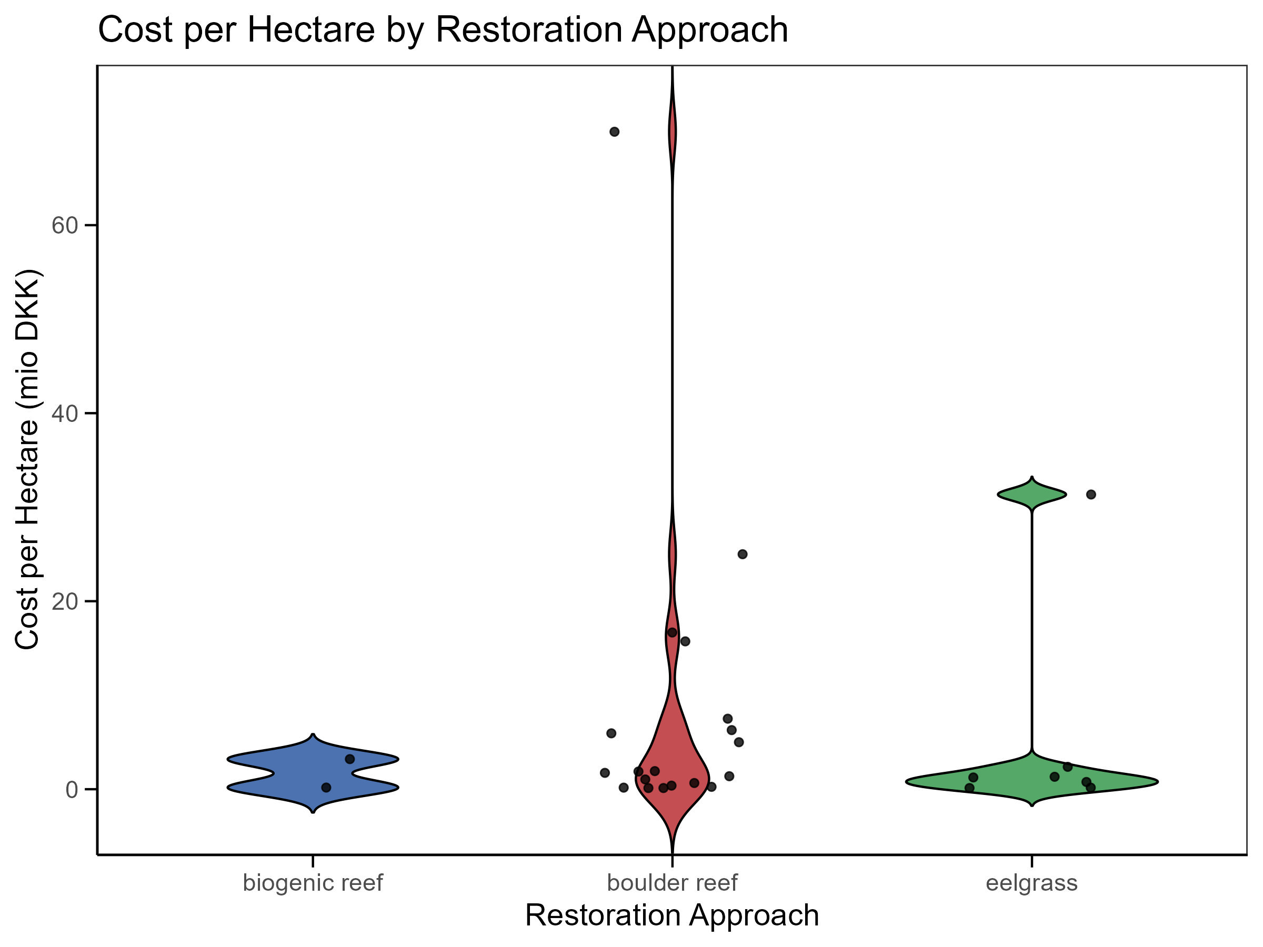
Experiences with marine restoration in dk
~ 2 billion €
~ 8 million €
~ 5.4 million €
~ 2.7 million €

Slide 10
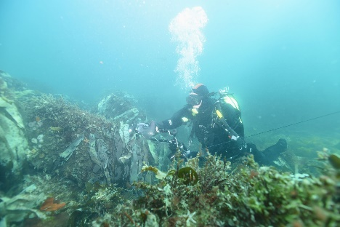
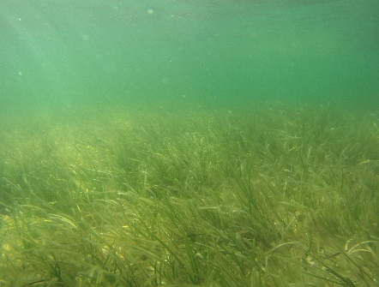
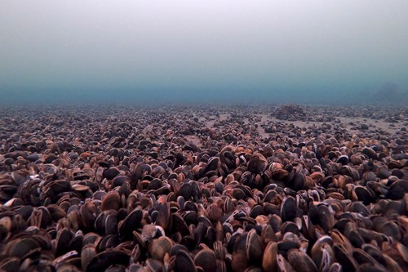
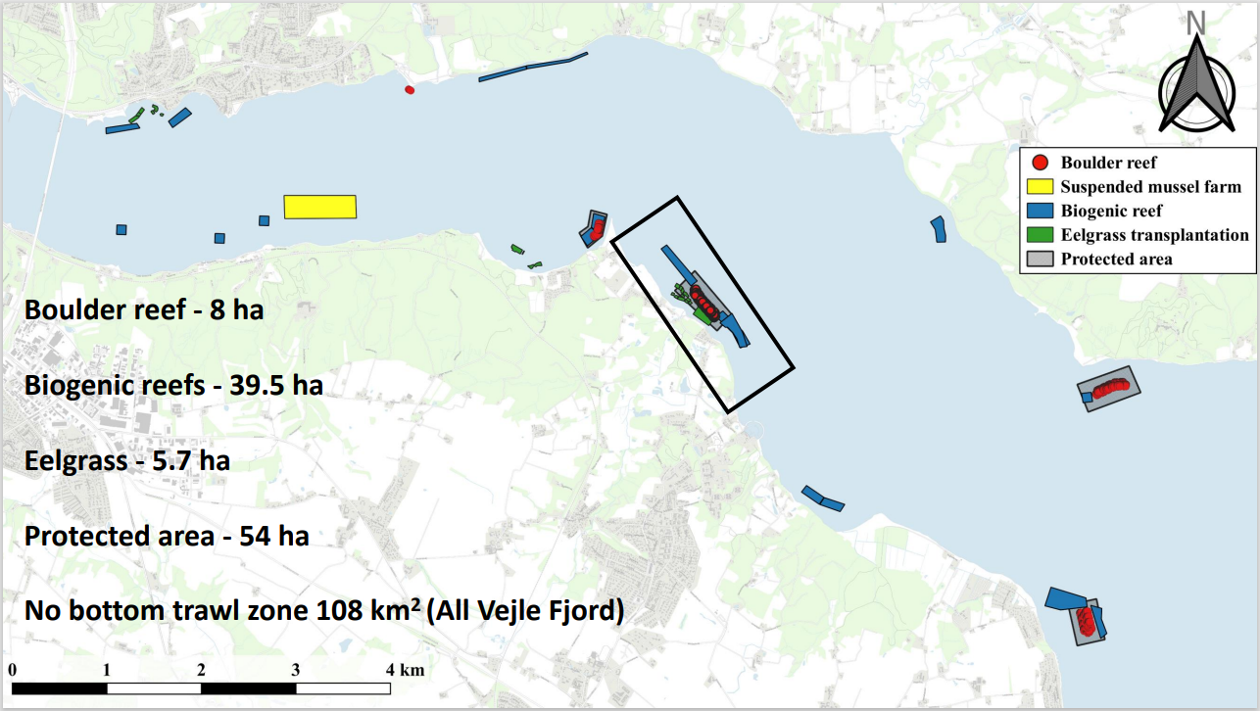
SEASCAPE restoration
Marine habitat- nursery - fisheries spillover
Wave attenuation – coastal protection – substrate provisioning
Carbon and nutrient storage – water filtration
Sund Vejle fjord project

Slide 11
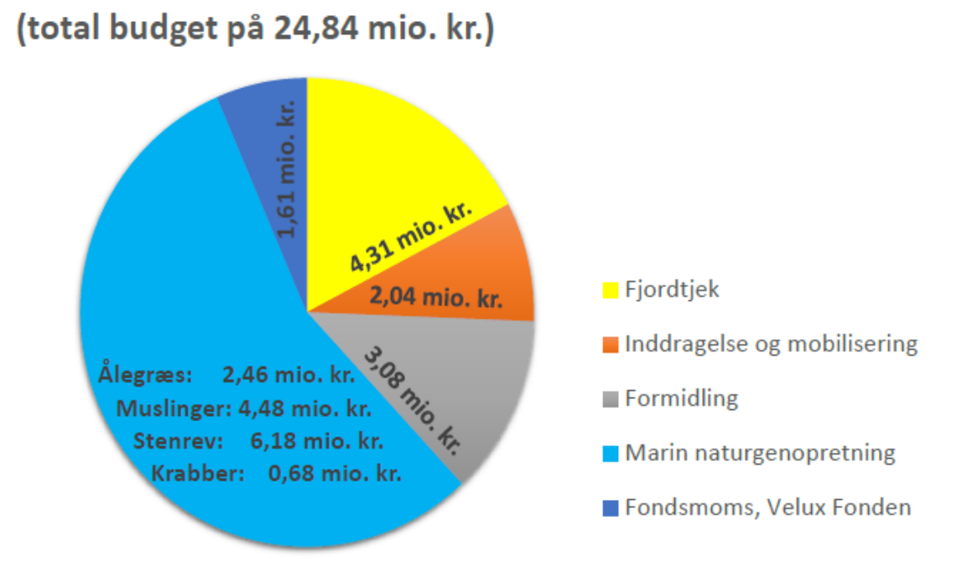
SEASCAPE restoration
= 3.330.522 euro
Fjord management
Public and stakeholders engement and awareness
Eelgrass:
Dissemination
Mussels:
Boulders:
Marine restoration
Crabs:
Taxes
Sund Vejle fjord project

Slide 12
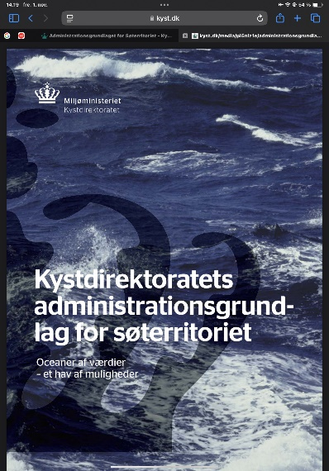
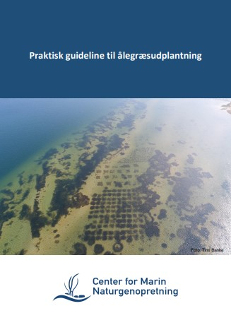
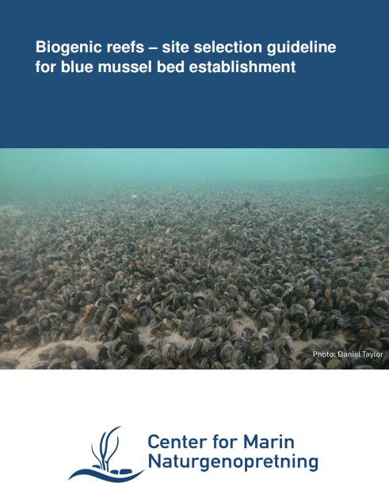
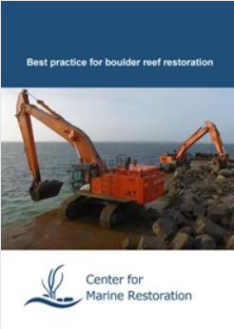
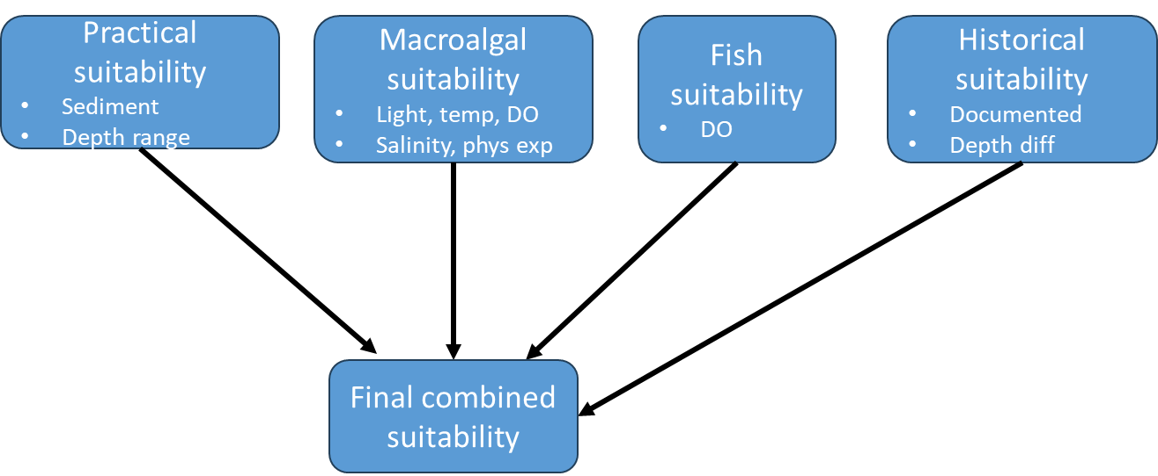
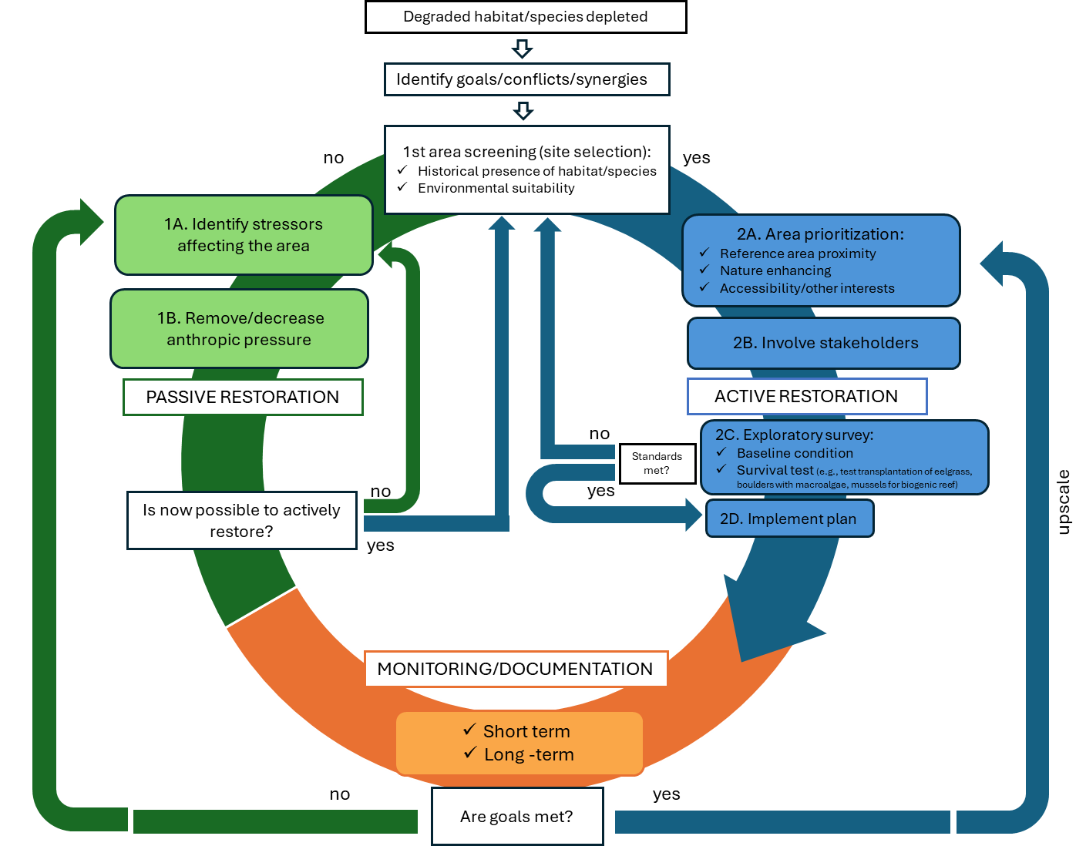
Guidelines and tools
Danish Coastal Authority (Kyst Direktoratet) for restoration projects permits
Guidelines for restoration developed by Center for Marine Restoration
Site selection tool for reef restoration (version 1)
Restoration data base
(updated regularly)
Restoration questionnaire
Decision wheel
And several others, have a look at: https://marinnatur.dk/

Slide 13
Need for more attention
Improved management of restoration projects (interests of conflict):
No regulation of eelgrass seed plant harvesting
Conflict between fishery regulation and biogenic reef restoration
Conflict between eelgrass, mussel beds and reef restoration
Restoration of habitats not part of the designation of Natura 2000 sites is tricky
Permitting new marine projects not aligned with new MFSD target on ”Benthic integrity”
How to best upscale restoration:
Monitoring guidelines with BACI approach needed
Indicators for quantification of restoration success (ecosystem services)
Cost efficiency of restoration types
Target one or more habitats?

Slide 14
Funding - Past and future
Funding of existing projects:
EU-Life (Reef restoration)
Velux foundation (boulder reefs, biogenic reefs and eelgrass)
Aage W Jensen (coastal realignment)
Ministry of environment (boulder reef projects)
National Park (boulder reef projects)
Future funding:
Havnaturfonden (500 mill dkr). (2024-2030) first projects autumn Special secretariat in the Danish EPA with an external advisory board

