Slide 1
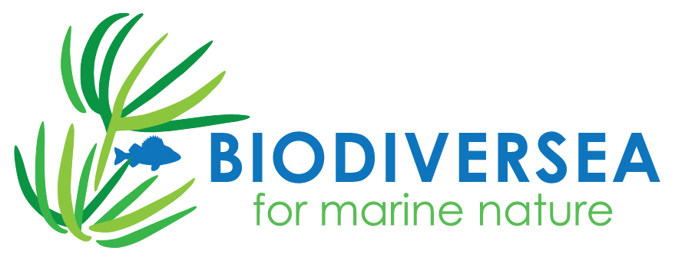


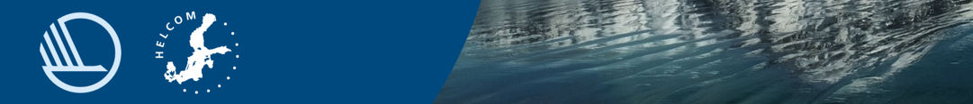
Habitat restorations in the coastal lagoons in Finland
Sanna Kuningas
Natural Resources Institute Finland (Luke)

Slide 2

LIFE-IP BIODIVERSEA project 2021-2029
Finland's largest cooperation project​
to safeguard the diverse nature of the Baltic Sea
~20 mil. €
567 000 € Luke restorations
9 partners
Developing a network of protected areas and its management in Finnish sea areas
Pressures on the biodiversity of the Baltic Sea and their management
Rehabilitation and restoration of species habitats
Development and piloting of an underwater diversity monitoring programme
Development of legislation and administration and the roles of maritime operators
Effective communication on the protection and importance of biodiversity in the Baltic Sea
Notes:
A9.4. henk.kust. 145.200€ = 153.200 €
C7. henk.kust. 292.000 €=413.500 €
YHT. 566.700 € -> 28.300 €/ site

Slide 3
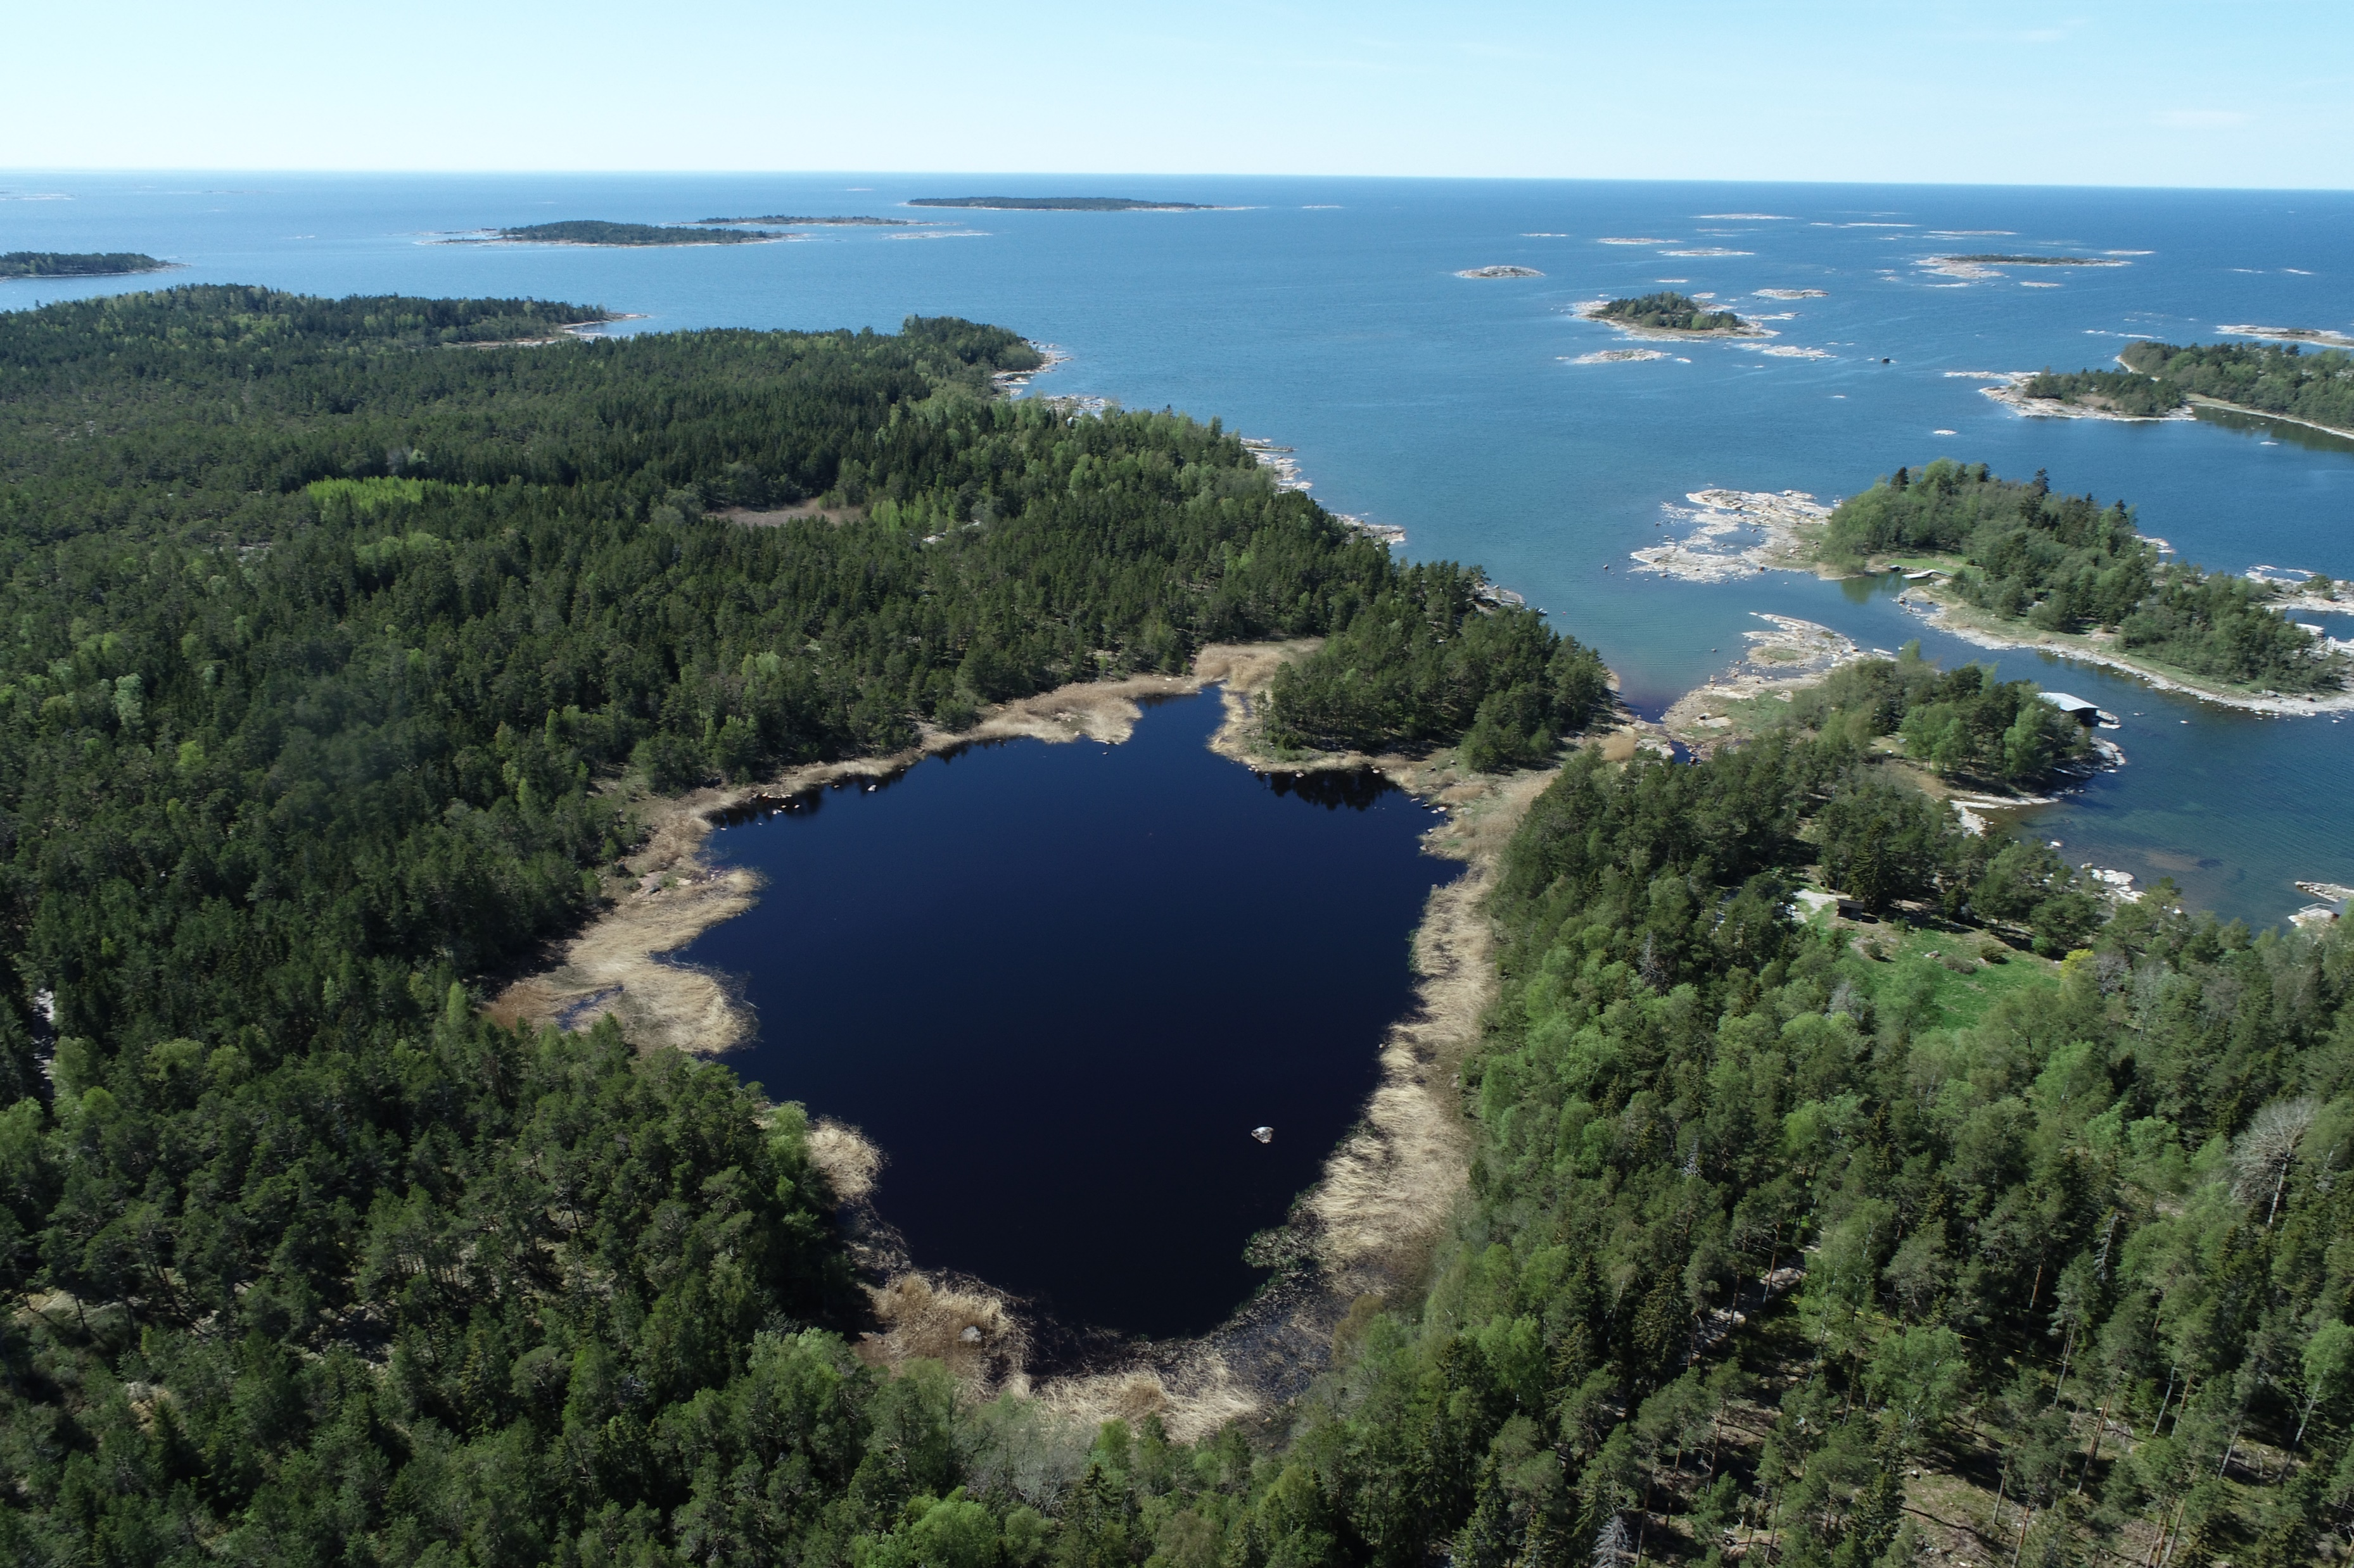
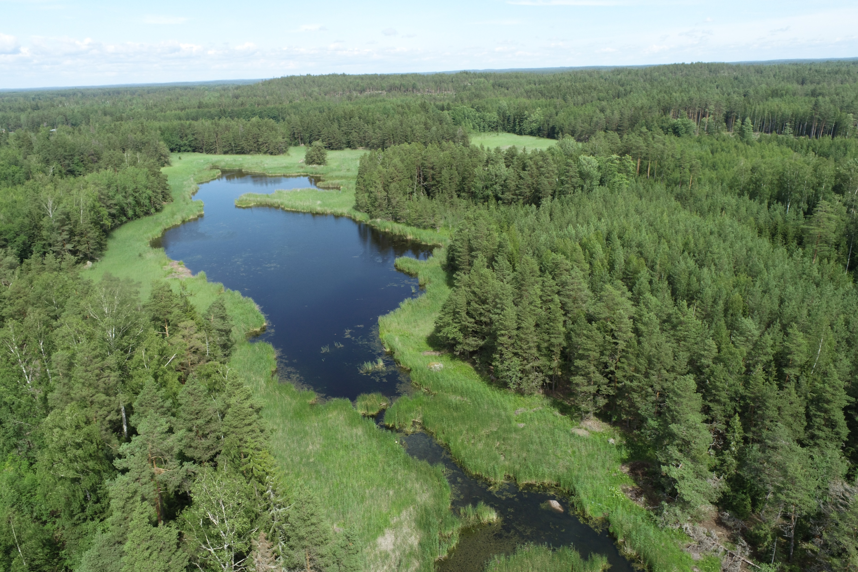
LIFE-IP BIODIVERSEA
Metsähallitus and Åbo Akademi - species restorations on Chara tomentosa, Zostera marina & Fucus vesiculosus
Luke – restorations on coastal lagoons to enhance natural reproduction of spring-spawning fish (perch, pike)
At least 20 coastal lagoons to be restored along the Finnish coast
Coastal lagoons – flads, gloes & gloe-lakes
Images: Sanna Kuningas, Luke

Slide 4
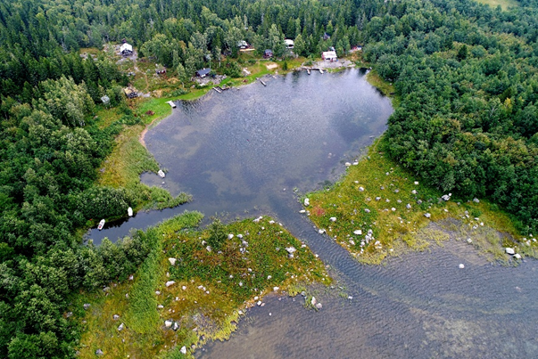
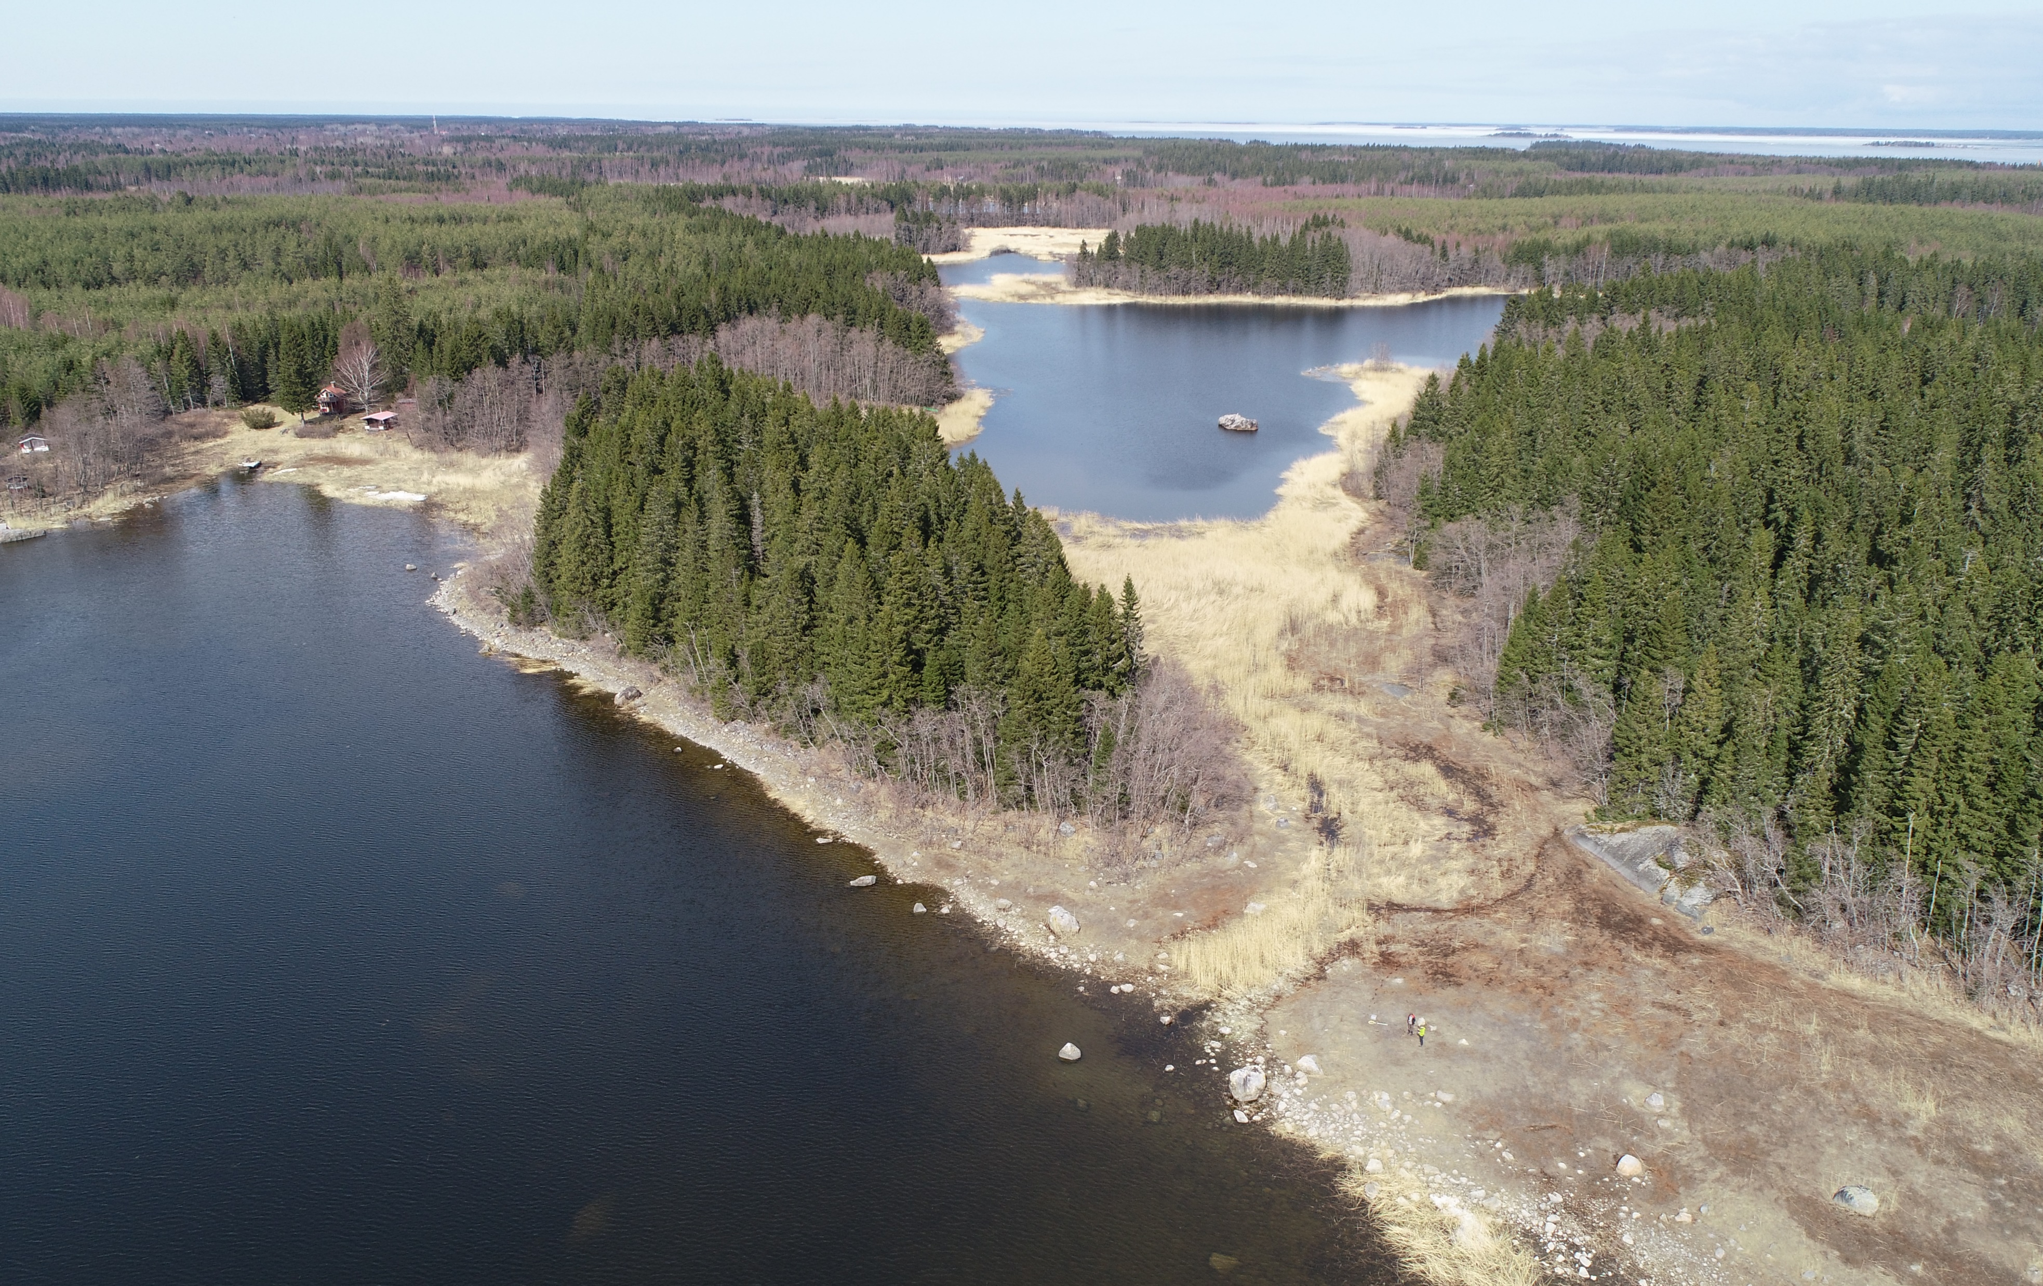
Typical issues in coastal lagoons
Images: Jaakko Haapamäki, MH & Lari Veneranta, Luke

Slide 5
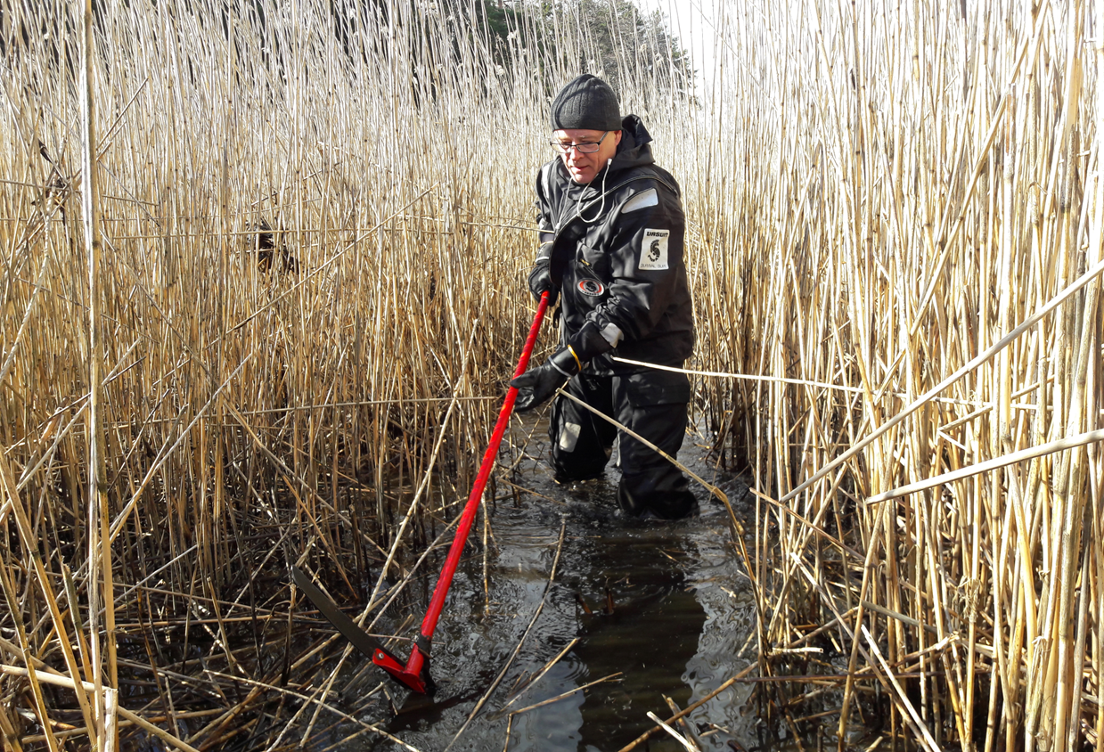
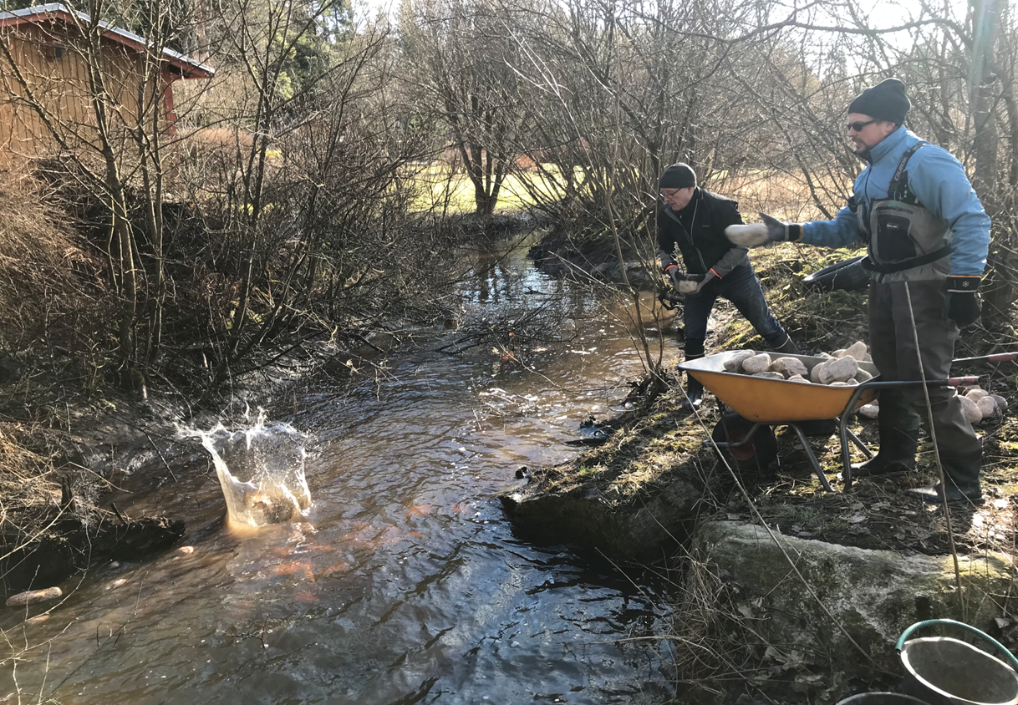
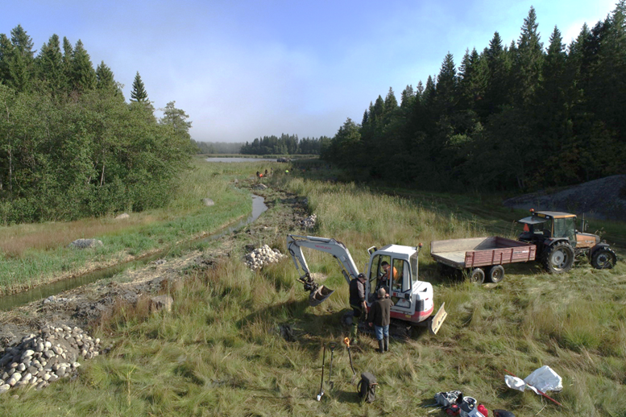
Examples of types of restorations & costs
Solbackfladan
Channel opening by hand
~3-4 weeks planning
1 day restoration
Materials 200 €
Monitoring 2 weeks
Total ~29 000 €
Byträsket
Narrowing channel
3 weeks planning
1 day restoration
Rock materials 500 €
Monitoring 1 week
Total ~19 500 €
Backfladan
Channel opening by machinery
2-3 weeks planning work
147 restoration h, partly volunteer work
1500 € machinery
3500 € materials
Total 23 700 € + monitoring €
Images: Sanna Kuningas, Mats Westerbom & Lari Veneranta, Luke
Notes:
Message – materials and actual restoration action might be cheap but before and after monitoring expensive!! Especially with expensive reseatch institute work force
Talkootyön hinta jatkossa?
Luke ohjehinta, erikoistutkija 6300€, kokonaiskustannus 18,700€, kokonaiskustannus plus kate 22,555e/kk
I

Slide 6
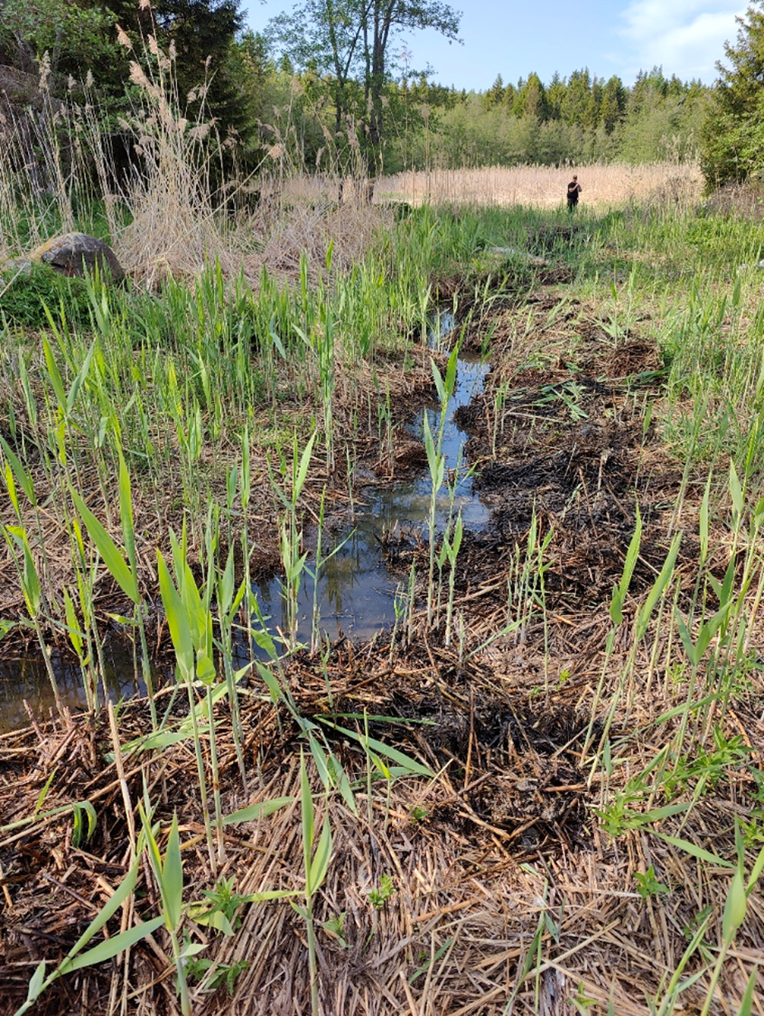
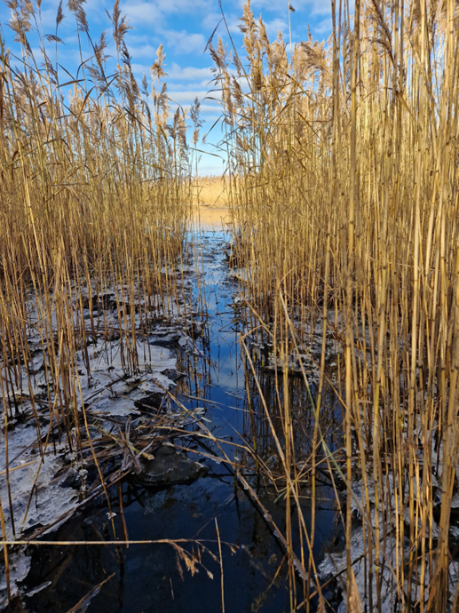
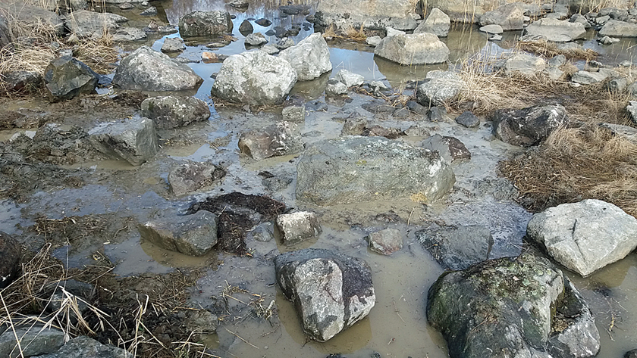

HELMI habitats programme
Co-operation with the LIFE-IP BIODIVERSEA project
Bastuskärssjön, Maalahti
Glo-flad, restoration of the channel and mowing of aquatic plants from the stream (2023-2024, continue 2025)
Total costs ~17 000 € + VAT 24 % (plan 2000 € + work 15 000 €)
Roliggropen, Korsnäs
Moving aquatic plans from channel 2022-2024 volunteer work; nature organisation Ostrobothnia Australis
Total costs ~9000 € + VAT 24 % (plan 2000 € ja work 7000 €):
Hålörarna, Luoto
Restoring the dredged channel to flad
1 working day
Total costs 3100 € + ALV 24 % (plan 1000 € + work 2100 €)
Images: HELMI Habitats Programme
Notes:
Consultant work for plans about 2000-4000 €

Slide 7
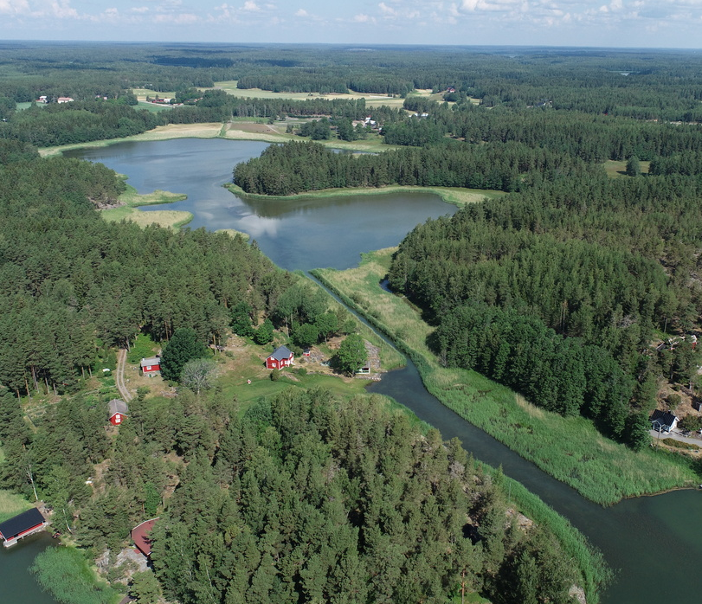
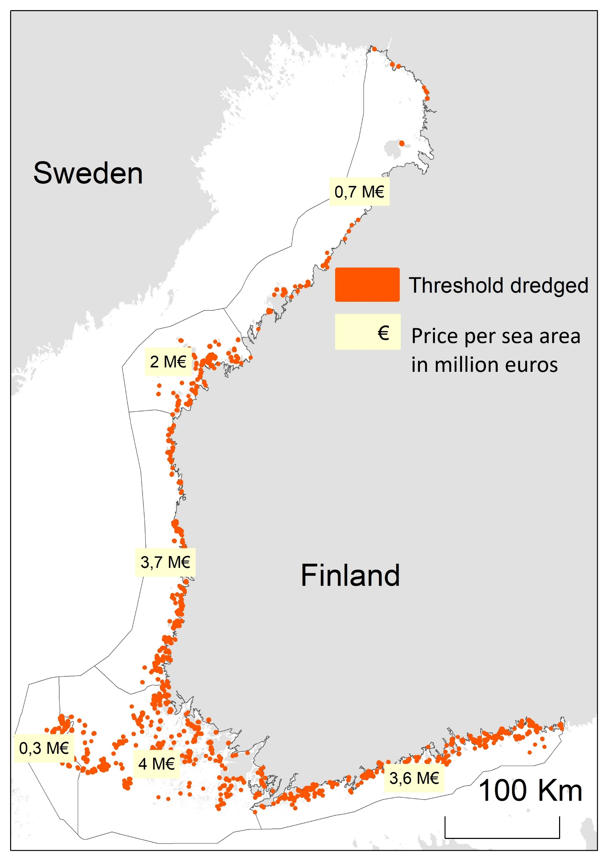
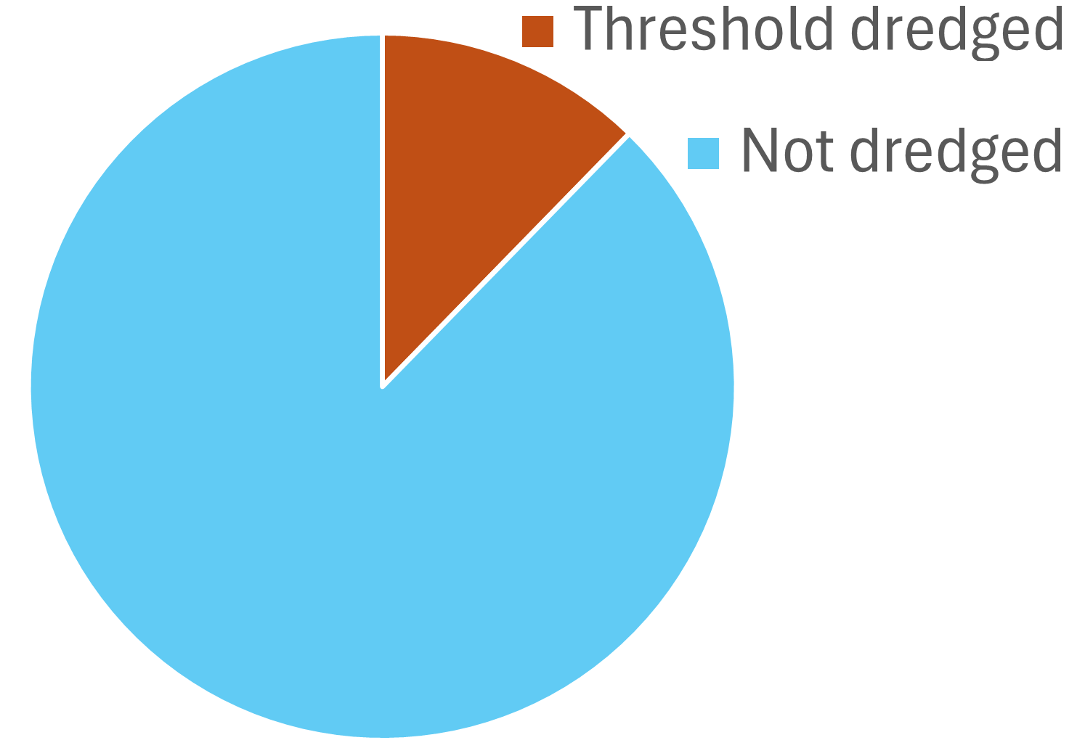
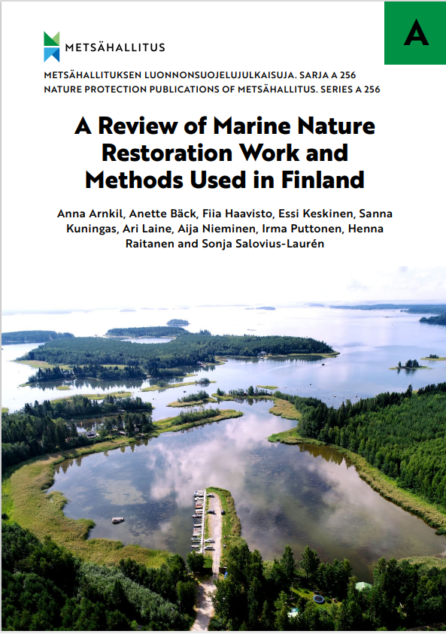

Average price for lagoon restoration ~16 000 euro
Price
14 510 000€
Images: Jaakko Haapamäki, Fiia Haavisto & Tytti Turkia, MH

Slide 8
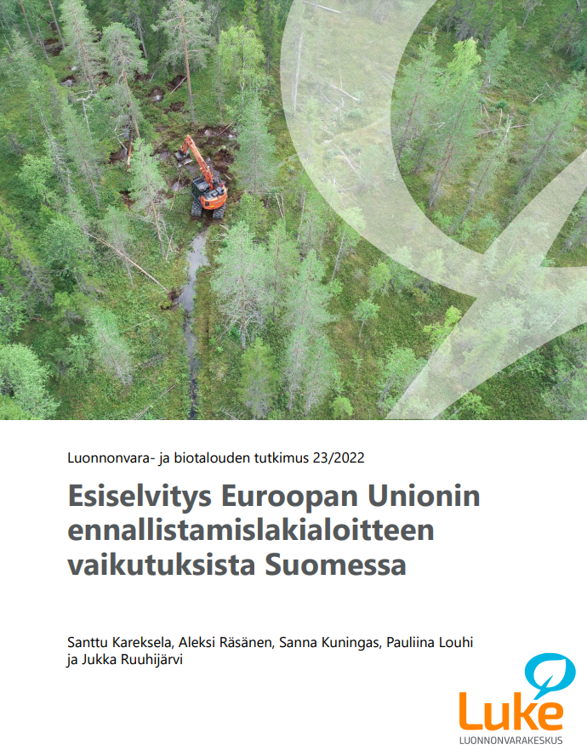
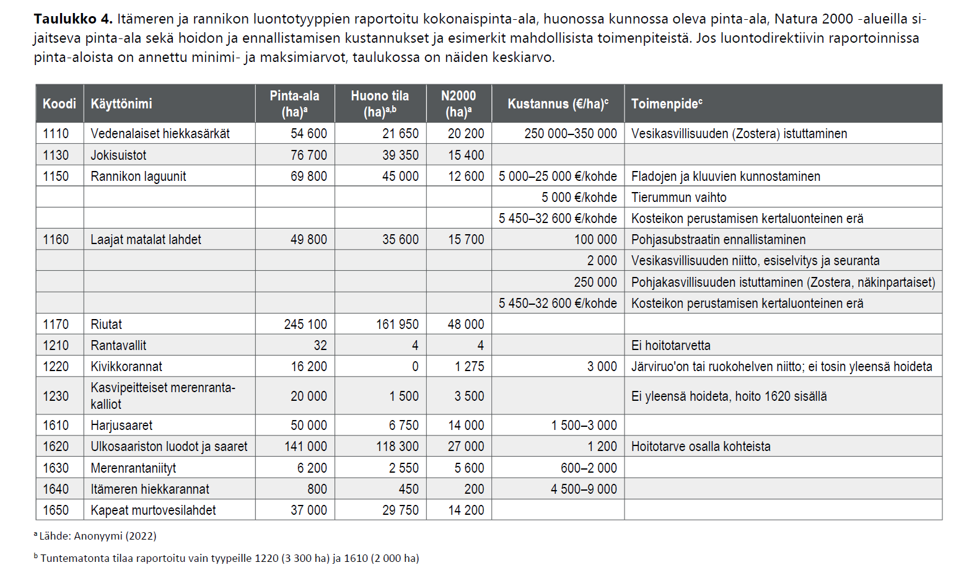
National plan for Finland
EU Nature Restoration Law
National plan work started
Ready on 18.8.2026
Preliminary work done on estimating costs, Kareksela et al. 2022
http://urn.fi/URN:ISBN:978-952-380-392-3
Notes:
Some of the most important work is done on land!! Minimizing nutrient flow to Baltic Sea!

Slide 9
​

Slide 10

sanna.kuningas@luke.fi

