Slide 1
Arctic Marine Ecosystem Restoration: Insights from Svalbard and the CLIMAREST project
Laura Wendling on behalf of the CLIMAREST project team SINTEF AS

Slide 2
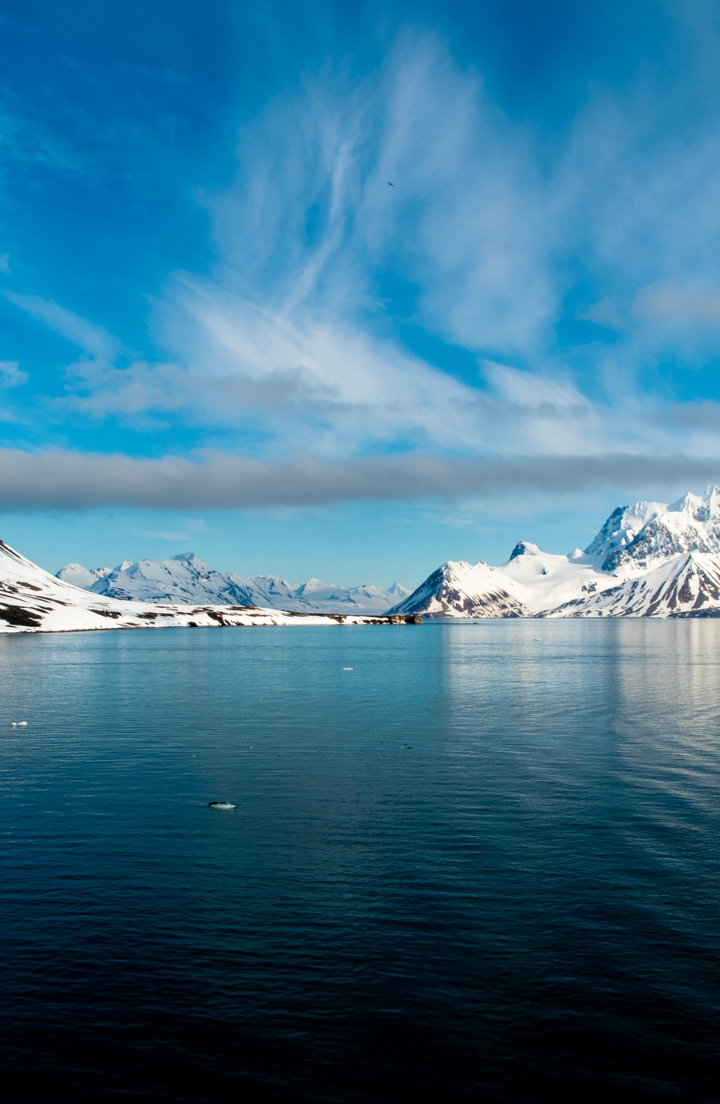
Coastal Climate Resilience and Marine Restoration Tools for the Arctic Atlantic basin
Large-scale restoration of coastal ecosystems for climate resilience in coastal communities
EU Mission: Restore our Oceans and Waters
Objective: develop a modular toolbox that integrates expert knowledge, scientific information, multilevel stakeholder involvement, ecosystem service assessment, cost-benefit analysis, action prioritisation, & customised protocols for restoring & monitoring diverse coastal habitats
Mission Ocean Innovation action
2022 – 2025 (3 years)
8.5 M€

Slide 3
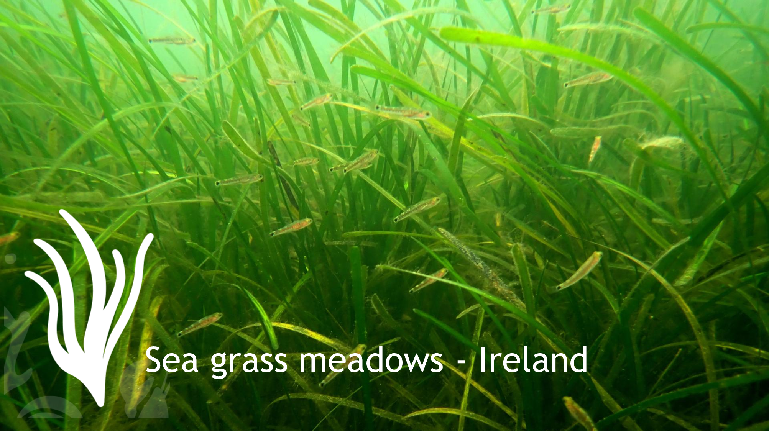
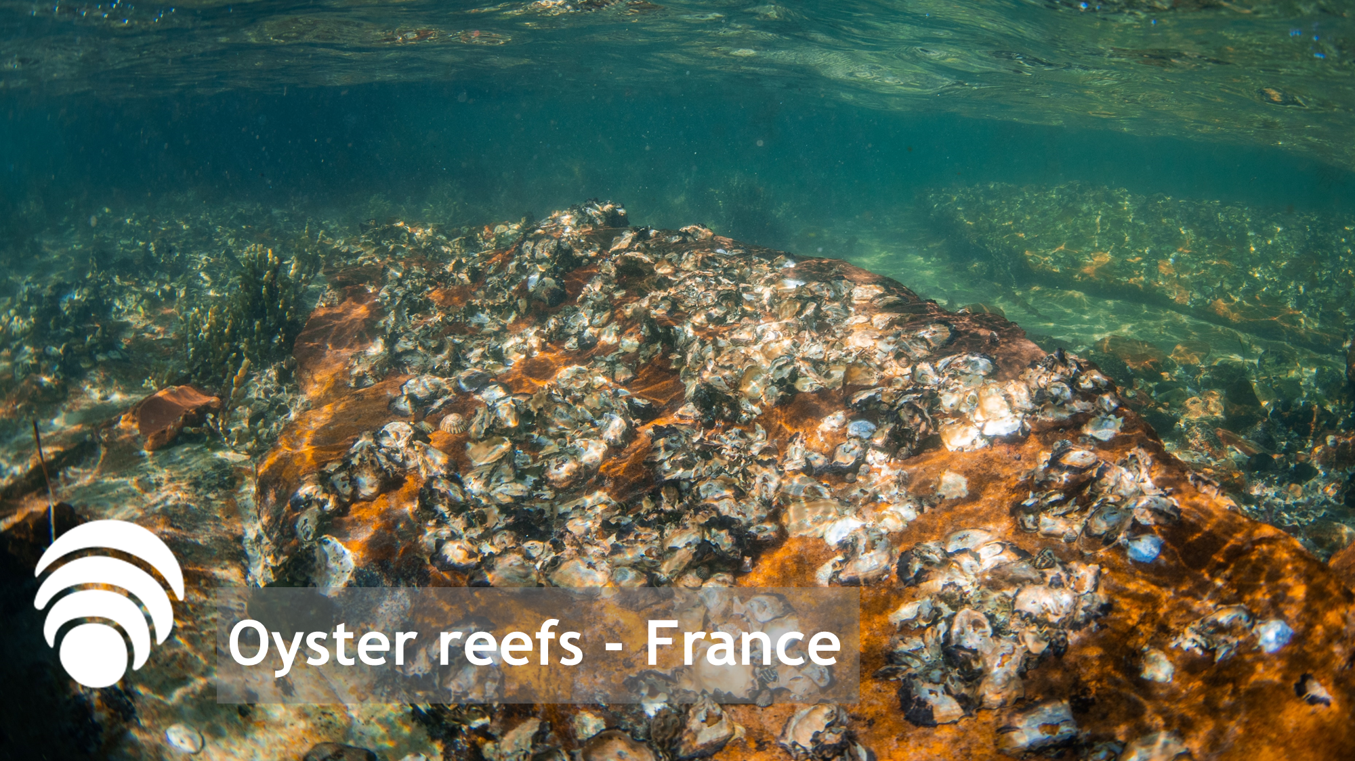
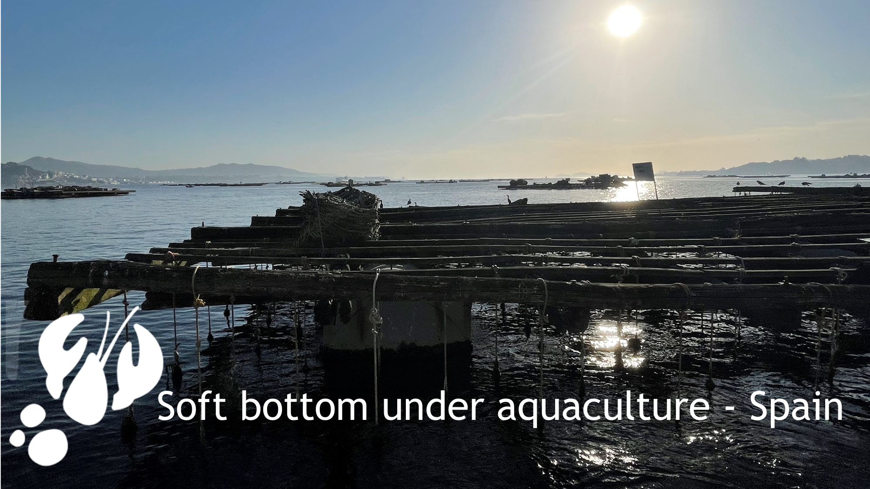
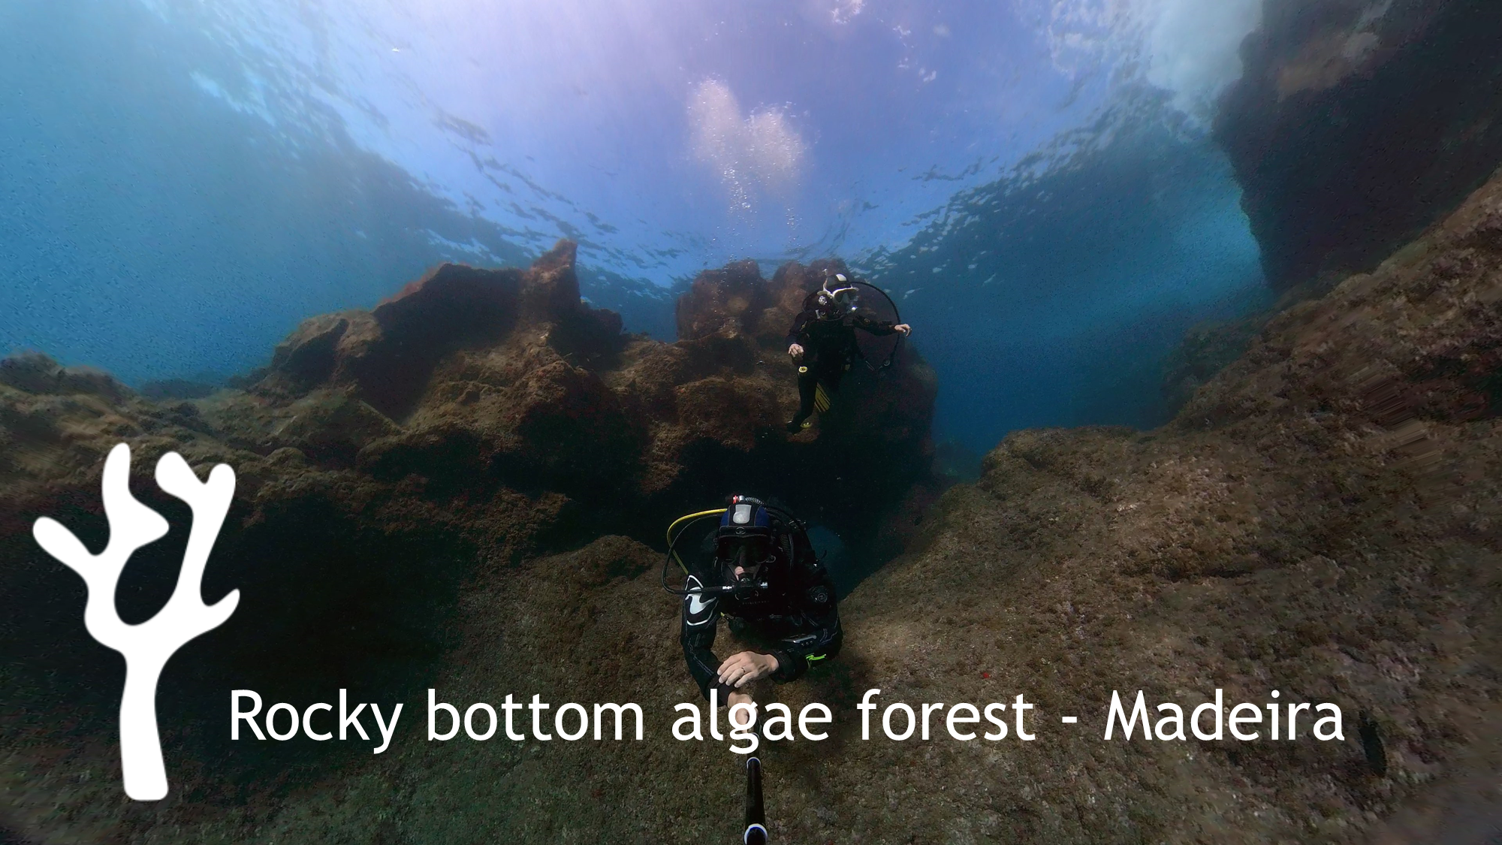
Arctic Atlantic Lighthouse
18 partners in 7 countries

Slide 4
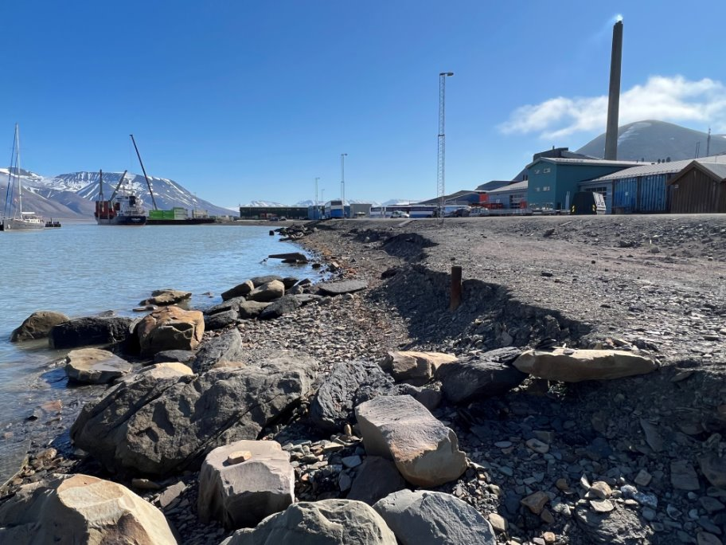
Coastal protection at permafrost coastline
Svalbard experiences exceptional warming rates 2-2.5 X the Arctic warming average & 5-7 X the global warming average (Isaksen et al., 2022)​
Shallow bathymetry, permafrost coastline, soil with low bearing capacity (sedimentary bedrock)
Prevent coastal erosion through sustainable measures
Conserve & protect biodiversity, minimal environmental footprint
Employ co-creation to systematically address human needs
Optimise affordability, technical simplicity & effectiveness through design
Remediation-Rehabilitation by replacing an artificial landform with a replica of a natural landform
Image © A. Sinitsyn, all rights reserved

Slide 5
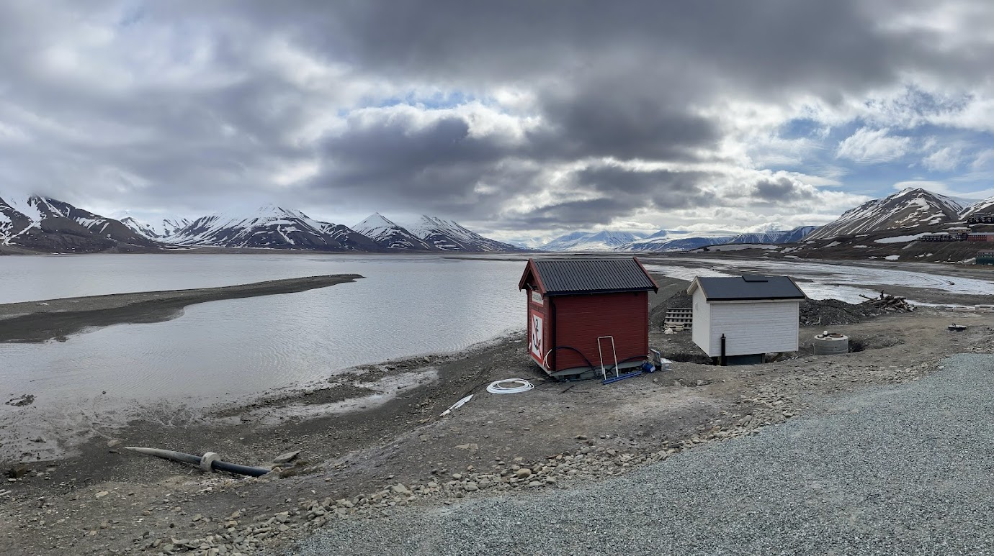
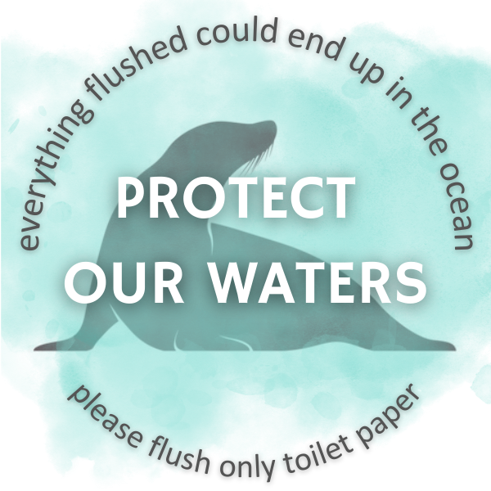
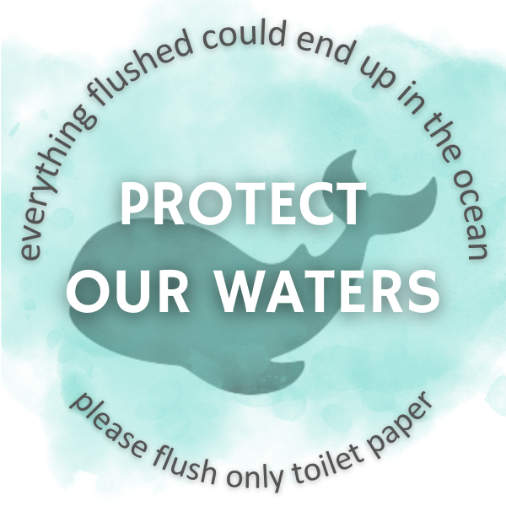
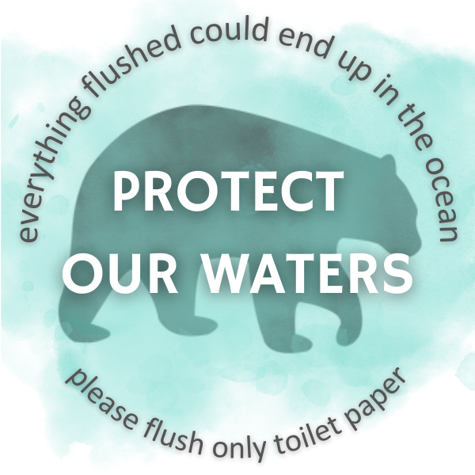
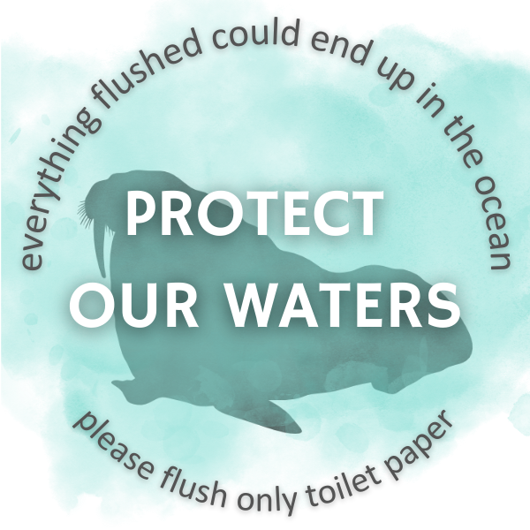
Reduction of pressure to recipient ecosystem
Ca. 2500 residents of Longyearbyen
All homes connected to central wastewater system
Pipes carry wastewater to a central discharge point
6 mm sieve provides mechanical treatment of wastewater prior to discharge
Adventfjorden is recipient waterbody
Impact Reduction-focused actions to increase awareness among local community that everything flushed can end up in the fjord
LINK TO VIDEO

Slide 6
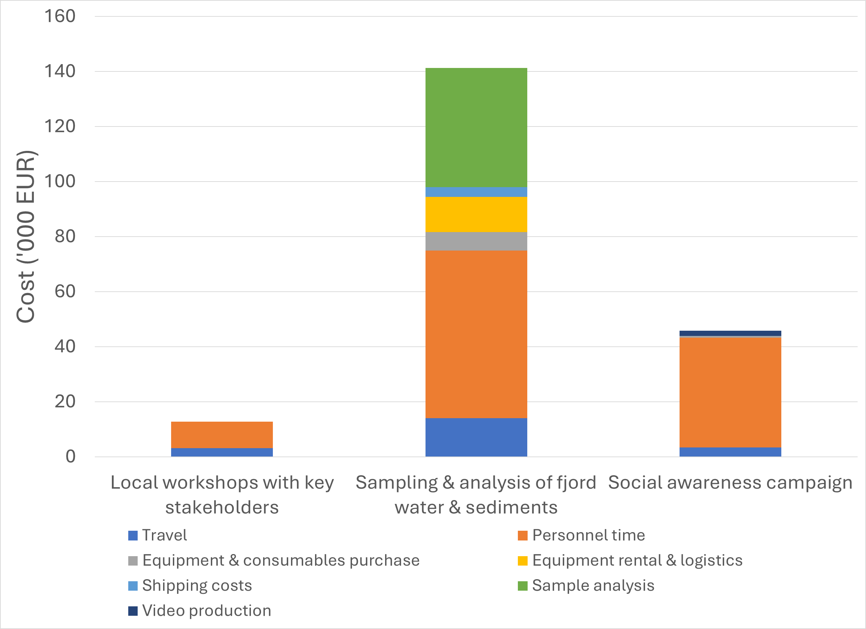
Costs of baseline assessment & social awareness campaign
Collaboration with local decision-makers, and key actors in tourism & recreation industries
Campaign primarily targeting visitors to Svalbard
Ca. 140,000 overnight stays in Longyearbyen in 2023

Slide 7
Lessons learned: costs of ecosystem restoration activities in Svalbard
Limited funds, materials, equipment & personnel + logistical challenges
Relative cost vs. availability of funds for different phases
Planning, implementation, monitoring, maintenance
Broad stakeholder engagement, incl. building an understanding of benefits, is key to consistent business plans & identifying innovative financing
Non-structural measures play a significant role in the overall cost-effectiveness of measures focused on impact reduction, remediation & rehabilitation
Regulatory policy and pricing, preparedness planning, establishment of land use regulations, implementation of flood warning systems, etc.
Material circularity → re-use materials as possible
Exploit the full range of existing data & opportunities for citizen science
Combine initiatives as possible & apply systems thinking to visioning of solutions

Slide 8
Laura Wendling
laura.wendling@sintef.no
CLIMAREST
www.climarest.eu

