Slide 1

Cost-effectiveness of marine ecosystem restoration
Dr. Wenting Chen
Senior researcher
Norwegian Institute for Water Research

Slide 2
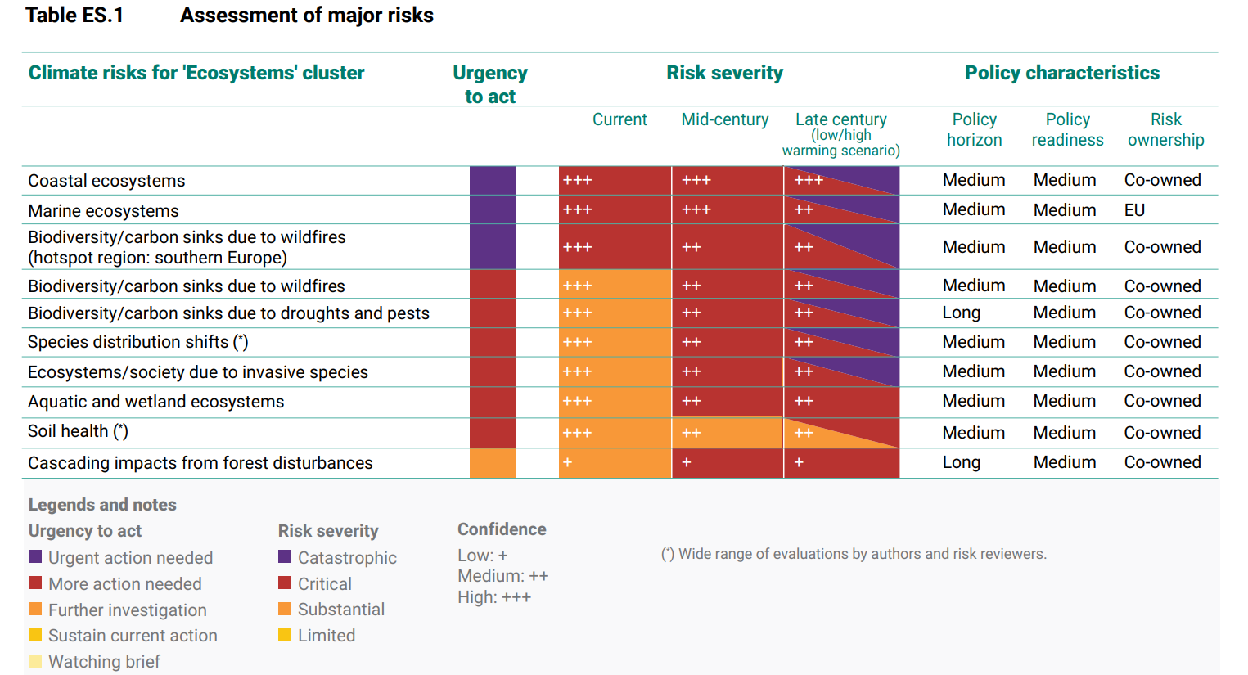
Marine ecosystem degradation
Coastal and marine
Ecosystems are facing critical to catastrophic impacts from climate change.
Source: European Climate Risk Assessment, EEA Report 01/2024
Notes:
he increasing concern that our planet is approaching a tipping point in sustainability, Over 80% of European habitats are in poor shape.
Worldwide coastal, marine, and estuarine systems have been degraded due to anthropogenic pressures such as reclamation, pollution, and destruction. Practically no marine area has not been affected by human activities . This degradation has led to considerable losses in biodiversity and ecosystem services, many of which are highly valuable.
Recent EEA report on European climate risk assessment has found the Among climate risks related to ecosystems, risks to coastal and marine ecosystems are the most severe in the current period and entail the highest urgency to act. • The functioning of marine ecosystems is threatened by the combined effects of climate-related drivers (e.g. marine heatwaves, acidification and oxygen depletion) and other anthropogenic drivers (e.g. pollution and eutrophication, fishing and the adverse impacts of maritime activities). This can result in substantial biodiversity loss, including mass mortality events, and declines in ecosystem services.
Building on a Decade of the Ocean Health Index – ScienceDirect
The Ocean Health Index defines a healthy ocean to be one that sustainably delivers a range of benefits to people now and in the future. 2023 is only 73 out of 100.
Ocean Health Index (OHI) addressing multiple needs: help set targets for healthy oceans, develop indicators to measure the status of ocean health,

Slide 3
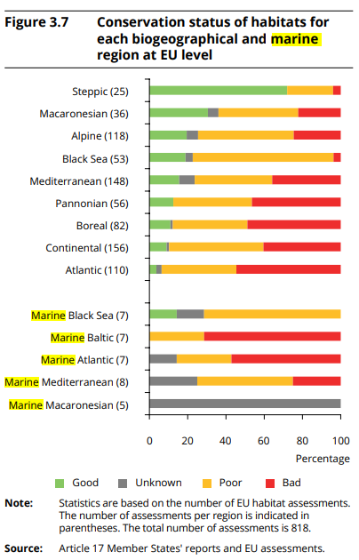
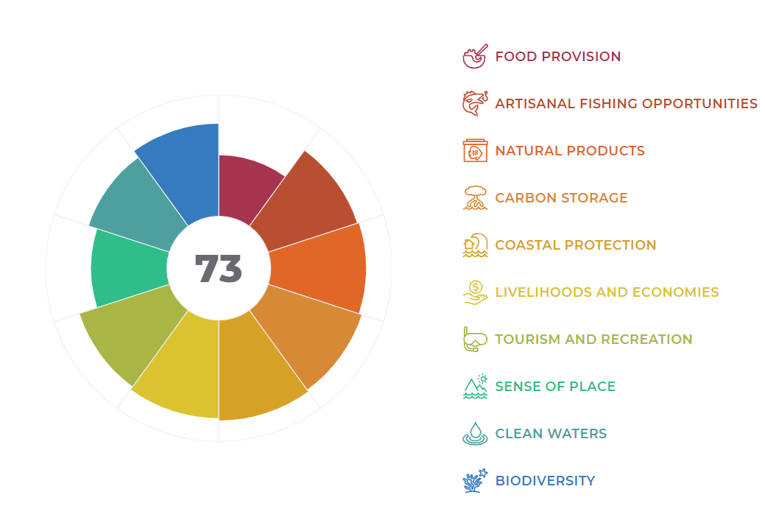
Marine ecosystem degradation
https://oceanhealthindex.org/global-score 2023
Notes:
Building on a Decade of the Ocean Health Index – ScienceDirect
80% of the world habitat is in bad condition. Conservation status for most habitats at EU marine regions are poor and bad.
The Ocean Health Index defines a healthy ocean to be one that sustainably delivers a range of benefits to people now and in the future. 2023 is only 73 out of 100.

Slide 4
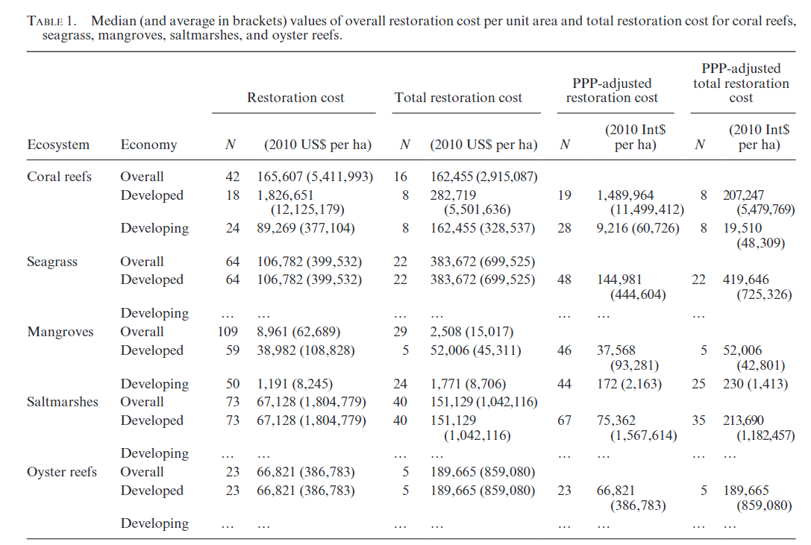
Marine ecosystem restoration
EU restoration law
EU countries must restore at least 30% of habitats in poor condition by 2030, 60% by 2040, and 90% by 2050
Restoration costs are high
Bayraktarov et al. 2015 The cost and feasibility of marine coastal restoration, Ecological Applications, 26(4), 2016, pp. 1055–1074
Notes:
A number of reviews are available on the costs of marine ecosystem restoration (Spurgeon, 1999; Bayraktarov et al., 2016, 2019). These reviews demonstrate that the costs of restoring coastal and marine ecosystems can vary substantially, depending on the technique, the habitat, and the scale of the operation. The costs of restoring seagrass, for example, vary between US$ 6,654 ha⁻¹ and US$ 4,106,047 ha⁻¹ (in 2010 prices), with a median of US$ 106,782 ha⁻¹; for coral reefs in developed countries these numbers were US$ 7,647 ha⁻¹, US$ 143,000,000 ha⁻¹, and US$ 1,826,651 ha⁻¹, respectively (Bayraktarov et al., 2016).

Slide 5
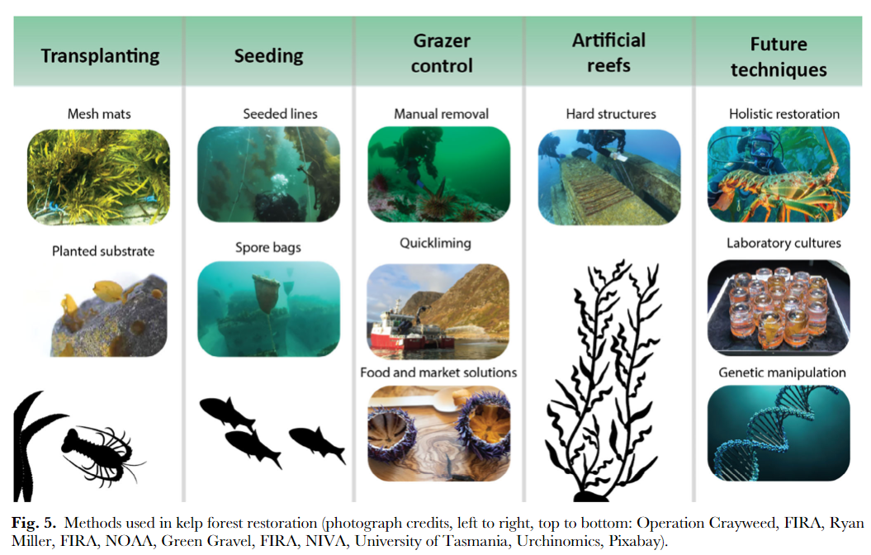
Marine ecosystem restoration
Marine ecosystem can be restored by different measures.
Various measures require different costs and will generate various outcomes.
Some benefits can be valued with monetary values, while others not.
Policy relevant question:
What restoration measures shall we invest in to achieve the restoration targets and at the same time minimize costs?
Source: Global kelp forest restoration: past lessons, present status, and future directions
Notes:
The EU Biodiversity Strategy to 2020 (European Union, 2011) aims to have restored at least 15% of degraded ecosystems by 2020.(OHI) addressing multiple needs: help set targets for healthy oceans, develop indicators to measure the status of ocean health,
Eurestorarion law.
EU countries must restore at least 30% of habitats in poor condition by 2030, 60% by 2040, and 90% by 2050
Over 80% of European habitats are in poor shape
Marine ecosystems can be restored in a number of ways, including transplantation of seeds, juvenile plants, or pieces of coral; removal of natural grazers or predators; or translocation of entire populations or habitats. Such efforts, however, require considerable resources. Therefore, it is imperative that policy makers understand the order of magnitude of the costs of restoration, the factors that determine restoration costs, and the trade-offs at stake.
Various approached require different costs and will generate various outcomes.
Policy relevant question:
What restoration measures shall we invest in to achieve the restoration targets and at the same time minimize costs?
A policy alternative is deemed cost-effective if, of all potential alternatives under consideration, it achieves the objective at the lowest costs

Slide 6
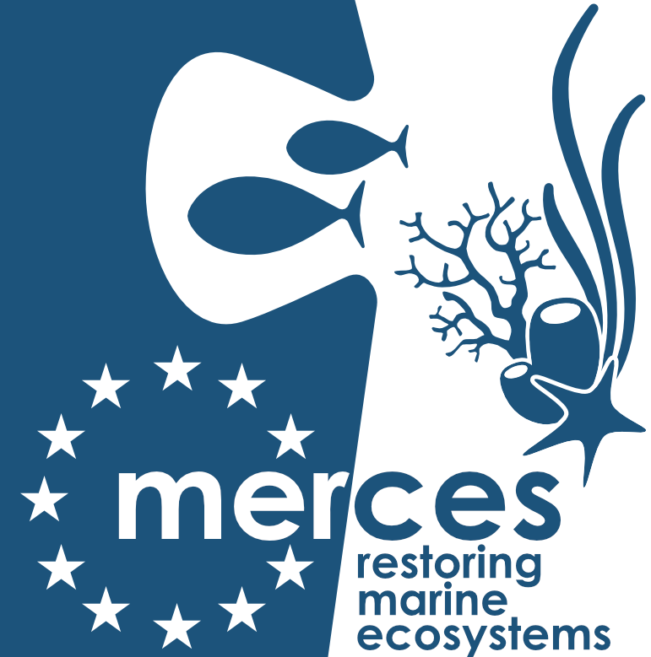



Cost-effectiveness (CE) of marine ecosystem restoration
CE is used for the restoration projects where benefits are not expressed in monetary terms.
Costs of different measures are compared given the restoration target is achieved.
Different methods achieve the targets at different time span and with different degree of certainty
Effectiveness can be connected to a minimum success rate (H2020 MERCES approach)
 | Restoration measures
 | Measure 1 | Measure 2 | Measure 3
Target success rate | 0.95 | 0.95 | 0.95
Expected success rate at each restoration cycle | 0.45 | 0.90 | 0.35
Number of attempts | 6 | 2 | 7
Cost (NOK/m2) | 76.0 | 47.8 | 27.3
PV (mill NOK) | 1.6 | 0.5 | 1.1
Notes:
CEAs are well suited when working with ecosystem restoration where benefits and targets seldom are directly economical. Given that a CEA analysis shifts the focus from monetary value to effectiveness, the main requirement for the unit of effectiveness is that it can be measured and quantified
Different from usual cost effectiveness analysis, restoration and conservation has high uncertainty in the success rate. When different restoration methods achieve restoration goals at different time spans and with different degrees of certainty, a fair comparison requires that the costs are compared at similar degrees of effectiveness.
Therefore it is important to Connecting cost-effectiveness with restoration and conservation success

Slide 7
Stressors control- widening the concept for restoration
Multiple impacts on marine habitats: for example
impacts of trawling on sea floor
Discharge from aquaculture and aquiculture
Invasive species
Marine litter
Overfishing
It is Important to include costs for stressors control as part of the restoration measures.
Danovaro et al. 2021. Marine ecosystem restoration in a changing ocean, Restoration Ecology, pp. 1-8

Slide 8
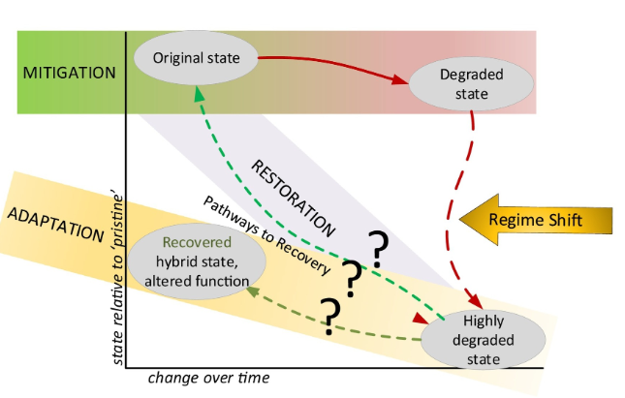
Deal with uncertainty
Three types of uncertainties
(Ounanian et al. 2018)
Incomplete knowledge
Unpredictability
Ambiguity
Sheaves et al. 2021. Restoration of marine ecosystems: Understanding possible futures for optimal outcomes, Science of the Total Environment volume796, 148845
Notes:
Besides the restoration success rate, there are other major uncertainties related to restoration activities, including the restoration costs, the societal values,
Ounanian et al. (2018) mentioned three kinds of uncertainties related to marine ecosystem restoration, namely: incomplete knowledge, unpredictability, and ambiguity.
Incomplete knowledge results from lack of data and limitations on data accessibility and quality. Knowledge gaps are common concerning the structure, function, biodiversity and interactions in marine ecosystems and these may increase the research costs.
Unpredictability is a common feature arising from the complex, dynamic and non-linear behaviour of natural, technical, and social systems, and should be considered in the governance of marine restoration.
Ambiguity could stem from different perceptions on the same phenomenon by different actors. Elsewhere, in a review of the literature Deely et al. (2020) identified over fifty barriers that could hinder restoration efforts being used as nature-based solutions.
Restoration of marine ecosystems: Understanding possible futures for optimal outcomes - ScienceDirect

Slide 9

Wenting.chen@niva.no

