Slide 1
Nature Restoration Regulation
Provisions for marine restoration
Vedran Nikolić, European Commission, DG Environment, Nature Conservation Unit

Slide 2
Nature Restoration Regulation (NRR)
Why? Continuing ecosystem degradation and biodiversity loss across the EU, impact of disasters/climate change, voluntary targets of the EU 2020 Biodiversity Strategy not met, economy depending on healthy ecosystems,…
Builds on and complements existing EU policy framework: Nature directives, Water Framework Directive, Marine Strategy Framework Directive, climate legislation,…
Urgency: regulation - applies directly to Member States
In force since August 2024
Habitats Directive
Marine Strategy
Framework Directive
Nature Restoration Regulation
Water Framework Directive
Birds
Directive

Slide 3
20% of EU land and sea by 2030
All ecosystems in need of restoration by 2050
Recovery of ecosystems
Climate action and land degradation neutrality
Enhancing food security
EU international commitments
NRR objectives and framework
Overarching objectives
Restoration targets and obligations
Implementation framework
Financing
Article 3(3): ‘restoration’ means the process of actively or passively assisting the recovery of an ecosystem in order to improve its structure and functions with the aim of conserving or enhancing biodiversity and ecosystem resilience […]
The EU #NatureRestoration Law (europa.eu)
Notes:
Commission have proposed a regulation, as this creates more consistency and coherence in the EU and is also a better fit with the urgency of the matter as there is no need for transposition in national law. But the regulation will be written in such a way that it will leave a lot of flexibility to the Member States on how to achieve the targets and obligations.
We are aiming at an overarching restoration objective coupled with a set of binding targets for specific ecosystems, to ensure a broad coverage of ecosystems to be restored, resilient and adequately protected.

Slide 4




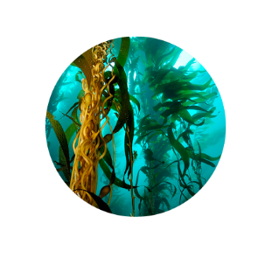

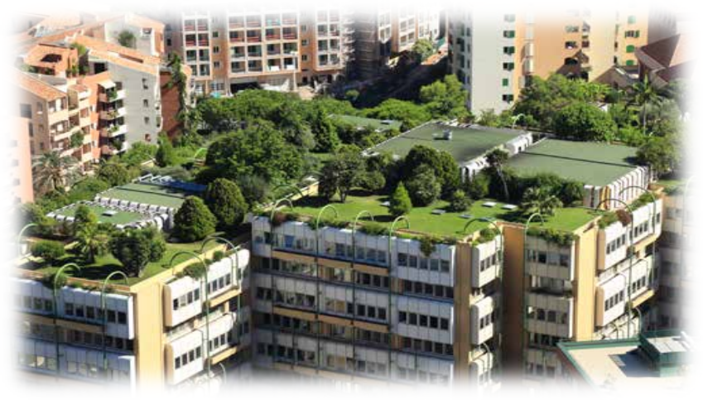

Specific restoration targets
Protected habitat types (Annex I HD)
Habitats of protected species (BHD)
Marine habitats
(beyond HD)
Urban ecosystems
River connectivity
Pollinators
Agro-ecosystems
Forest
ecosystems
Notes:
The proposal contains these overarching restoration objectives coupled with a set of binding targets for specific ecosystems, to ensure a broad coverage of ecosystems to be restored, resilient and adequately protected.

Slide 5
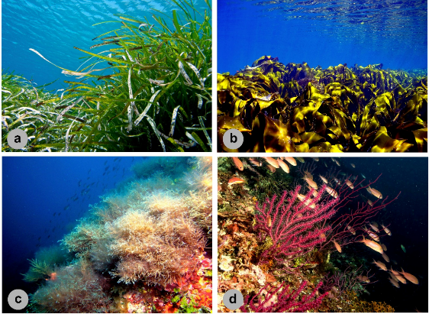
Obligations for marine ecosystems
Restoration of coastal (Art 4., Annex I) and marine seabed habitats (Art. 5, Annex II)
Use of tools from the common fisheries policy
Submission of joint recommendations - 18 months before deadline for targets
Annex II Groups 1 to 6: seagrass beds; macroalgal forests; shellfish beds; maerl beds; coral, sponge and coralligeneous beds; vents and seeps
Put in place measures to improve to good condition areas not in good condition
2030 – covering at least 30% of total area not in good condition
Re-establishment of habitats to reach their favourable reference area
2030/2040/2050 – 30%/60%/100% of additional area for each group from 1 to 6
Restoration of habitats of species
Quality and quantity of habitat, connectivity
Filling the knowledge gap
2030 – at least 50% of total area of all groups 1 to 6
2040 – all areas of all habitat types in groups 1 to 6, 50% of total area of group 7
Requirement to prevent non-significant deterioration
Area where good condition has been reached
Area in good condition or necessary to reach restoration targets
2050 – covering at least 90% of total area not in good condition
2050 – all areas of all habitat types in group 7
Covered by the Birds and Habitats Directives + additional species (Annex III)
Annex II Group 7: soft sediments (not deeper than 1000 metres of depth)
Annex I: estuaries, mudflats and sandflats, coastal lagoons,…
2040 – covering at least 60% of total area not in good condition
Some differences in targets between Articles 4 and 5 and between marine Groups 1-6 and Group 7
Derogations and flexibilities
Re-establishment at 90% if 100% not possible
Non-deterioration: derogation for force-majeure, unavoidable habitat transformations directly caused by climate change, overriding public interest, action or inaction of third country
Further derogation for renewable energy and defence activities

Slide 6
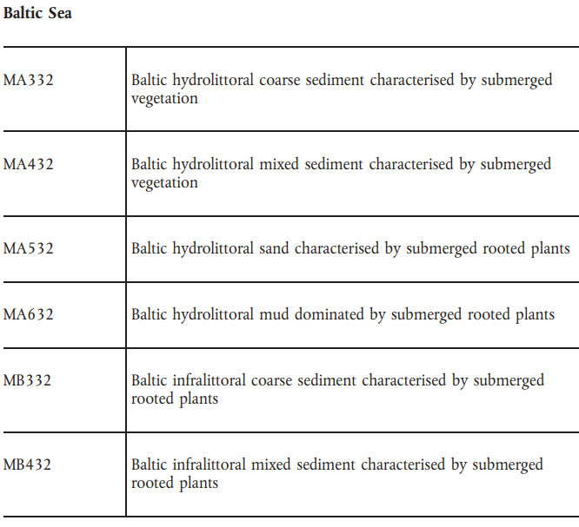
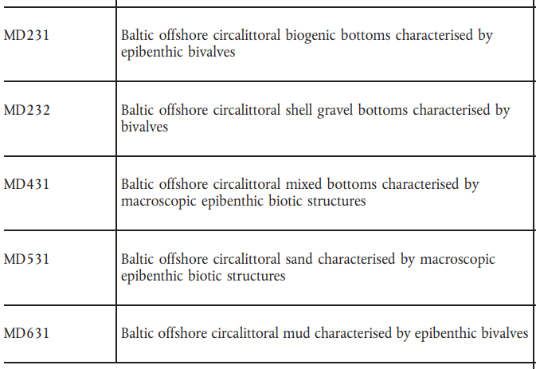
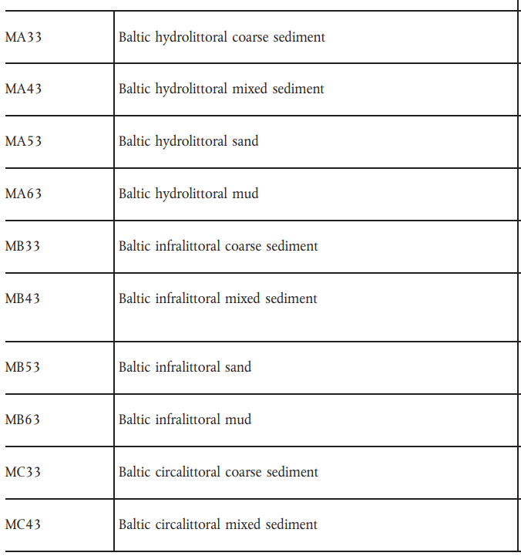
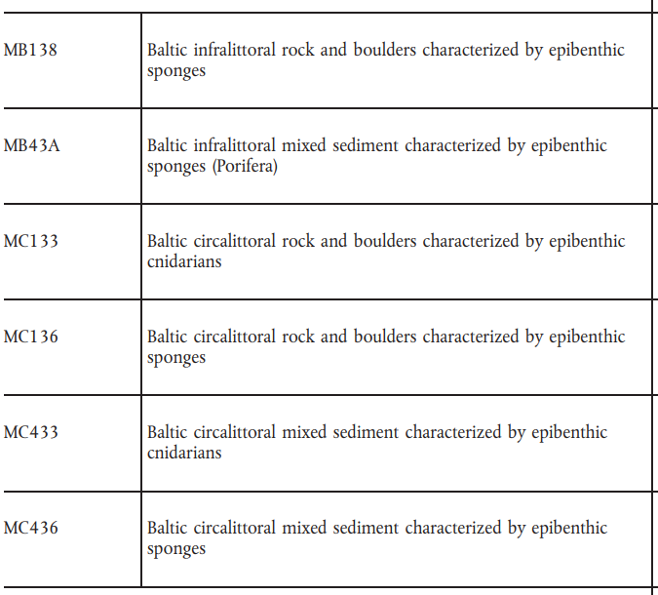
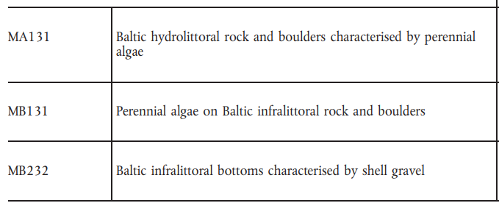
Restoration of marine habitat types (Annex II)
Seagrass beds
Macroalgal forests
Shellfish beds
Maerl beds
Sponge, coral and coralligenous beds
Vents and seeps
Soft sediments (above 1000 metres of depth)

Slide 7
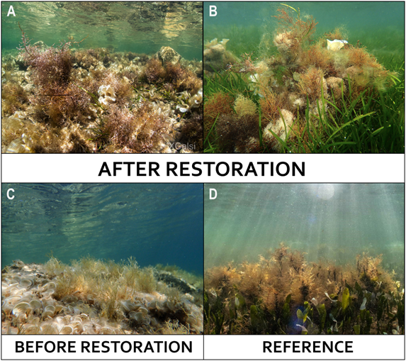
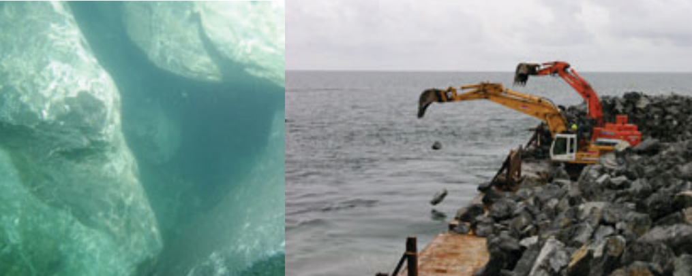
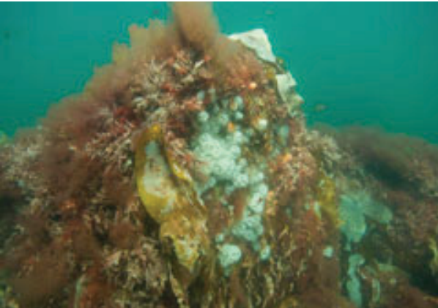
Challenges for marine restoration
Precondition for putting in place restoration measures is good mapping and assessment of condition of habitats but there are currently gaps in knowledge.
Marine restoration knowledge and practice are currently limited to certain habitats and areas, focusing mainly on active restoration (e.g. replanting of seagrasses, corals, macroalgae in coastal shallow waters).
More efforts in development and upscaling of restoration measures for all Annex II habitats and habitats of species, including through extensive use of passive restoration.
Source: https://doi.org/10.3389/fmars.2023.1176655
Source: Layman report of the LIFE project “Rebuilding of Marine Cavernous Boulder Reefs in Kattegat (“Blue Reef”)”

Slide 8
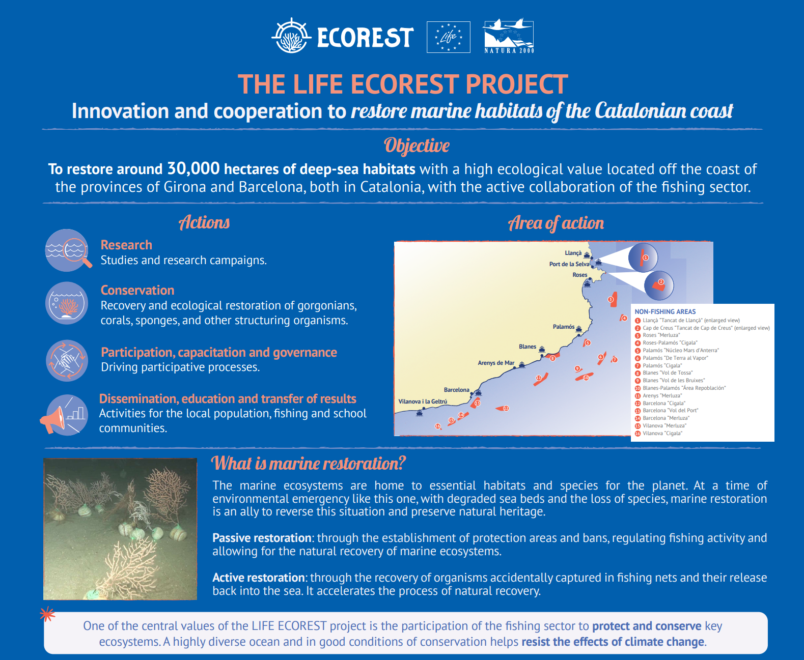

Restoration benefits ecosystems and society, including local communities!
Participation and engagement of all actors will be crucial for NRR implementation.
Small restoration actions must be up-scaled.

Slide 9
Preparatory work
Member States must prepare national restoration plans by August 2026 and carry out the preparatory monitoring and research needed to identify the restoration measures that are necessary to meet the targets and obligations.
National restoration plans will contain estimated financing needs for the implementation of restoration measures or other new obligations arising from NRR, and the means of intended financing (public or private, including with EU funding instruments).
Member States must, where possible, foster synergies with NRPs of other Member States, in particular where they share a marine region or sub-region
Member States may, where practical and appropriate, for preparing and implementing NRPs in relation to marine ecosystems, use existing regional institutional cooperation structures (eg RSCs).

Slide 10
Support for implementation
EU investments in biodiversity-related research (5%, € 3.5 billion)
Green Deal Call includes ecosystems restoration (€ 72 million)
> 441 Million euros on nature-based solutions portfolio
Horizon 2020
Horizon Europe
In total
Horizon Europe Missions:
A Soil Deal for Europe
Restore our Oceans and Waters
Biodiversa+
BiodivRestore knowledge hub
Cluster 6: Food, Bioeconomy, Natural Resources, Agriculture and Environment
LIFE PLP project to support the mapping, condition assessment and restoration measures for NRR-marine ecosystems (from 2025)
Support to Member States for the implementation of nature legislation (workshops and meetings)
Various guidance documents, EUNIS marine habitat manual and support to assist preparation of NRPs (EEA)
LIFE and Horizon Europe projects
2025: Report on funding needs, overview of EU financial resources and analysis of funding gaps

Slide 11

Thank you
Unless otherwise noted the reuse of this presentation is authorised under the CC BY 4.0 license. For any use or reproduction of elements that are not owned by the EU, permission may need to be sought directly from the respective right holders.

