Slide 1
On the EBM journey
Mark Dickey-Collas
@DickeyCollas

Slide 2
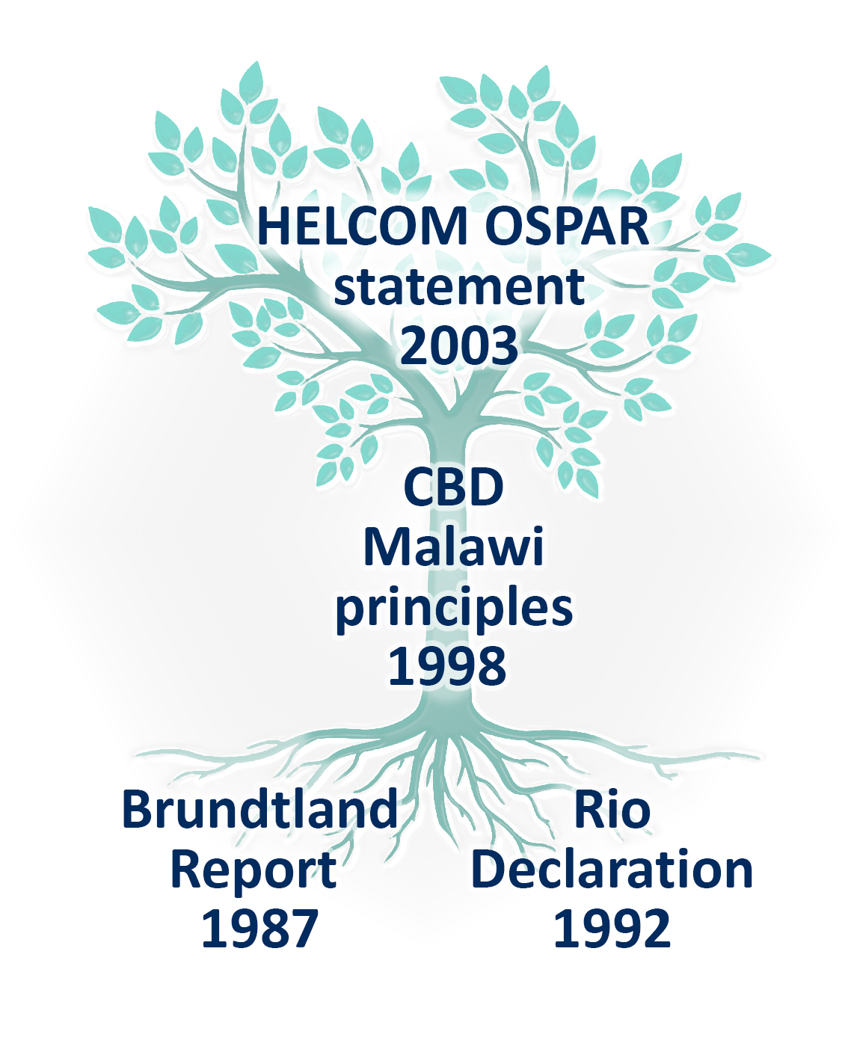
Roots of Ecosystem Based Management (EBM); Ecosystem Approach
Now embedded in much national/supranational legislation (e.g. EU marine strategy framework directive, marine spatial planning directive, common fisheries policy etc)
Socio-ecological system
https://www.ospar.org/site/assets/files/1232/jmm_annex05_ecosystem_approach_statement.pdf

Slide 3
https://www.cbd.int/ecosystem/principles.shtml

Slide 4
My interpretation of EBM
Ecosystem Approach is a concept for managing human activities that effect and draw from the ecosystem. Based on a set of aspirational principles that are designed to enable sustainable development of humans within a resilient and healthy ecosystem.
The principles guide the direction of change in management of human activities and implementing action for the conservation/restoration of the ecosystem.
It is evidence informed.

Slide 5
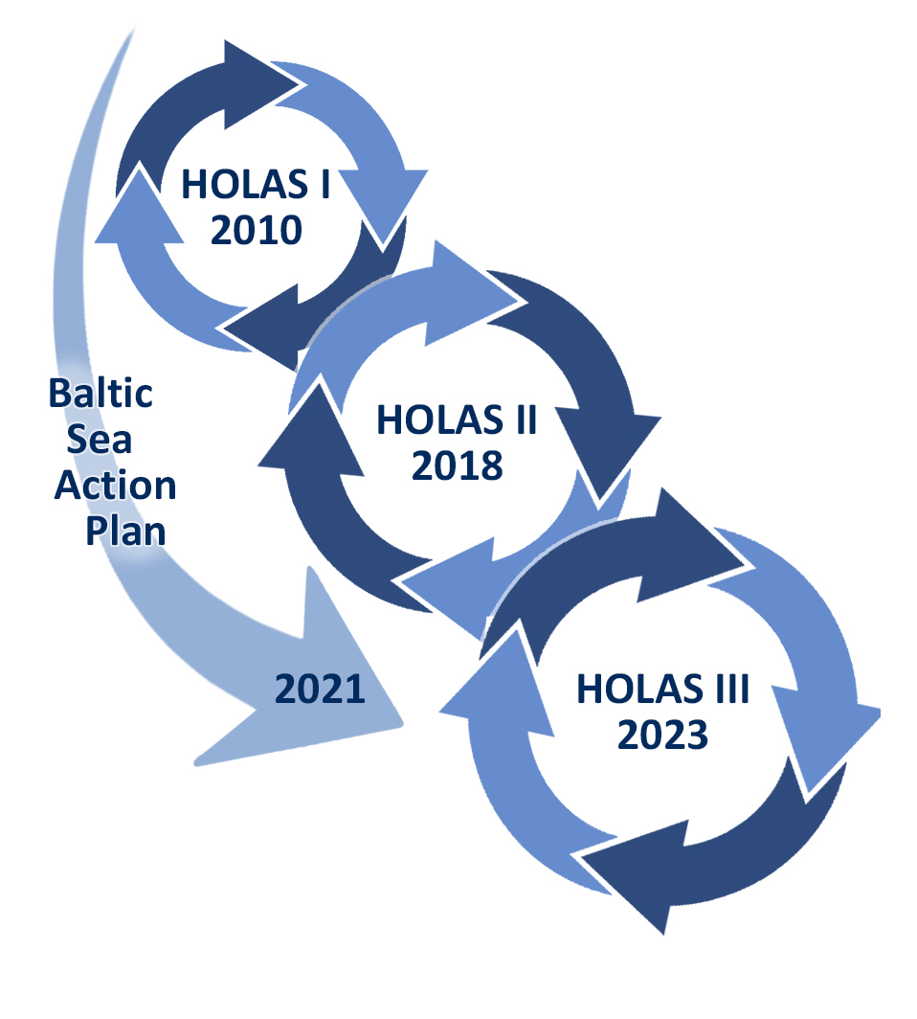
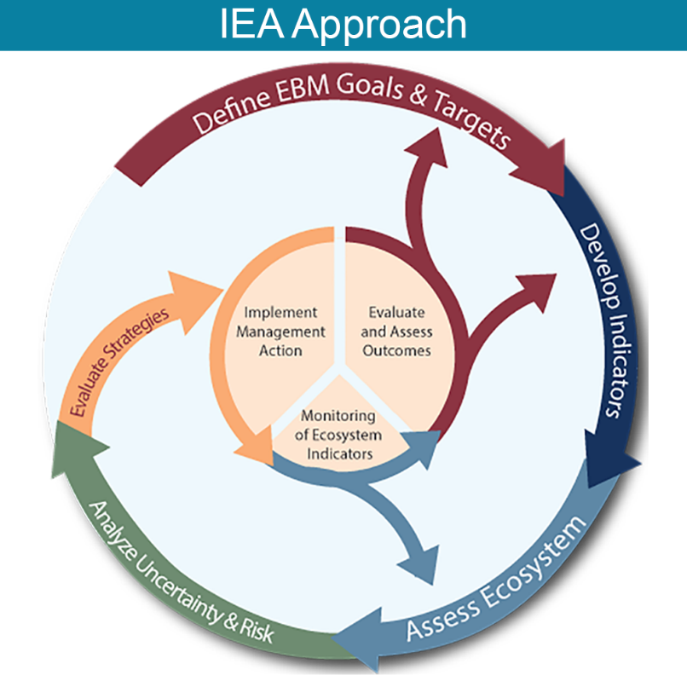
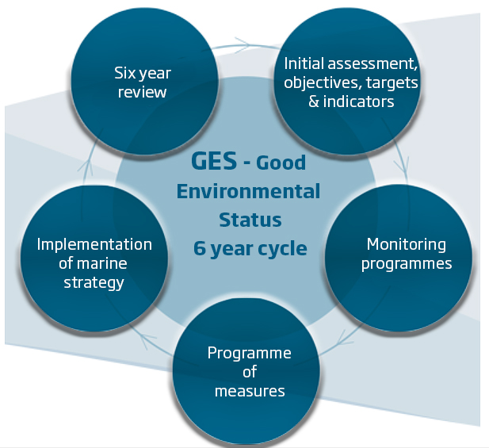
Implementing EBM - cycles
USA NOAA EU MSFD HELCOM

Slide 7
Bottlenecks to implementing EBM
Conflicting interpretations of laws & mandates
Administrative practices, routines, power dynamics, maritime boundaries
Imbalance across industrial sectors
Challenges of stakeholder involvement & coproducing knowledge
Conceptualizing EBM is context-specific
Crises swamp longer-term priorities
Rudd et al 2018

Slide 8
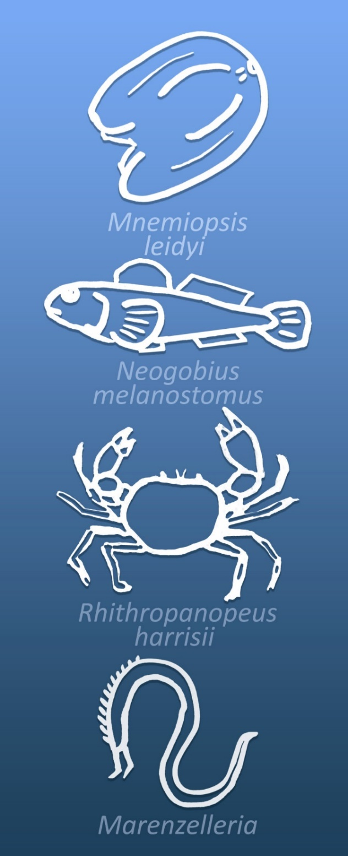
Moving forward
Monitoring & assessing ecosystem state is in hand.
The challenge is:
Prioritising the objectives (including social, economic & governance)
Implementing collective action to deliver objectives
Ensuring robust knowledge base on potential consequences of management action
How do we measure progress/success of EBM?

Slide 9
Experience from North Atlantic
EBM enables new benefits & opportunities; make the business case.
Yes, we can! Adequate mandates & effective tools exist for EBM.
Integration of human dimensions is essential for EBM; diversify the conversation.
Stakeholders don’t see their stake in EBM; engage & target ocean literacy to professionals.
A sustainable future requires a sustained investment in EBM; commitment is key.
https://www.atlanticresource.org/aora/sites/default/files/GalleryFiles/Publications/2019-06_Report_AORA_EA2OHS_vision_document.pdf

Slide 12
Three stations
Policy (HELCOM): What is the policy relevance of the ecosystem approach (EA), and how can ecosystem-based management (EBM) be incorporated into policies and implemented more easily? What are the barriers and opportunities? In particular, what should be considered for the BSAP update process, and what should possibly be included in the final updated BSAP?
Science (SWAM): what are the core principles of EA that are most relevant in the regional Baltic Sea context? How can science contribute to implementing EBM, how can EA concepts be applied to our sea-based activities, notably in maritime spatial planning? What new scientific questions need to be asked and priorities must be set, notably to accommodate EA visions and effective EBM implementation?
Society (CCB): where are the opportunities for successful implementation of EBM, what possible organisational changes are needed to further ecosystem-based management within the BSR? How can EBM be best applied across multiple sectors, and what are possible ways to increase actual implementation of EBM in the Baltic Sea region. Who are potential drivers for EBM implementation?

Slide 13
Three objectives
What are the basic principles of the Ecosystem Approach (EA) and Ecosystem-based management (EBM): What is the ecosystem approach, and how can ecosystem-based management best be implemented? The conference will seek to agree on a shared understanding between various sectors, narrowing down the EA concept to some key basic principles in order to facilitate its regional implementation through a common regional understanding and subsequent adherence and integration in the work of various Baltic Sea stakeholders.
Bottlenecks and opportunities: What are the bottlenecks to and opportunities for the implementation of ecosystem-based management? What could be concrete actions for a successful implementation, and what could be possible pilot areas and concrete use cases where implementation could be tested?
BSAP update: In addition to supporting the UN Decade of Ocean Science, the results of the conference may be used to support the drafting and implementation of the updated HELCOM Baltic Sea Action Plan (BSAP). The outcomes of the conference will be presented to the relevant HELCOM bodies

Slide 14
OSPAR HELCOM definition Ecosystem approach
Ecosystem Approach is a concept for managing human activities that effect and draw from the ecosystem. It is based on a set of aspirational principles that are designed to enable sustainable development of humans within a resilient and healthy ecosystem. The principles guide the direction of change in management of human activities and a call to action for the conservation/restoration of the ecosystem. There are a suite of similar concepts, and ecosystem approach stands out as it is already embedded in international treaties, regional plans and best practice guidelines.
Practically Implementing Ecosystem-Based Management

