Slide 1
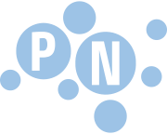
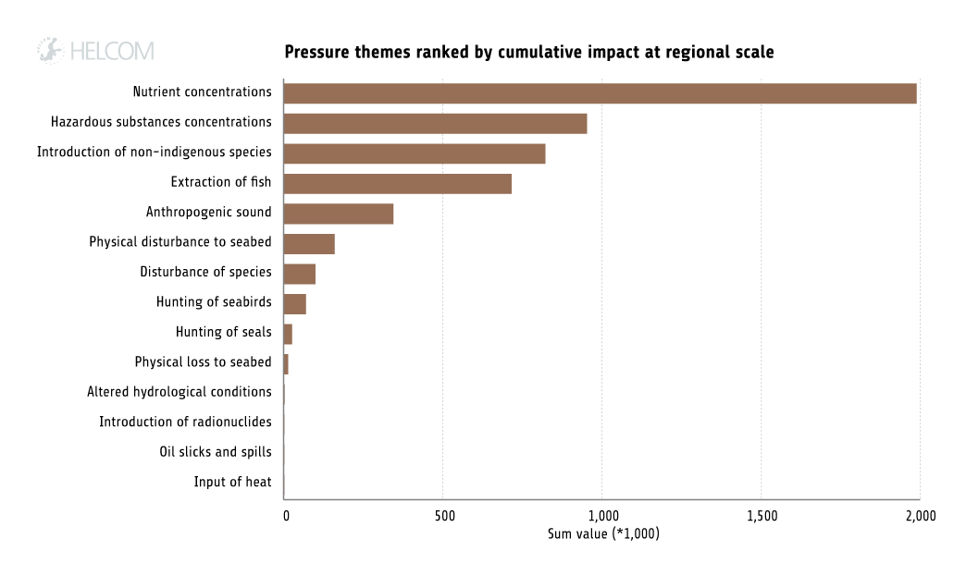
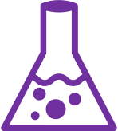
Top pressures on the Baltic Sea
Nutrients and eutrophication
Hazardous substances (and litter)
Non-indigenous species
Extraction
of fish
Underwater
noise
Disturbance of species, to seabed
Notes:
Eutrophication remains the largest single pressure on the Baltic Sea marine environment, with 97% of the waterbody affected to varying degrees. Eutrophication, the excessive concentration of nutrients in the sea, leads to a raft of consequences upsetting biodiversity, such as blooms of toxic algae and oxygen depletion. Losses due to eutrophication are estimated to be up to 4.4 billion euro annually, across all sectors. Today, the agricultural sector is the main source of nutrient inputs and eutrophication, but the Baltic Sea has, over the past decades, accumulated huge nutrient reserves from other sources such as industries and municipal wastewater.
Hazardous substances trends show improvement: Levels of contaminants are elevated and continue to give cause for concern. Many contaminants such as persistent organic pollutants (POPs) take a long time to degrade, and their impacts can magnify as they accumulate within the aquatic food web. However, the number of improving trends outweighs the number of deteriorating trends in the monitored hazardous substances. Acute pollution events from oil spills have also decreased.
Marine litter is a clearly visible problem along the Baltic Sea coastline. It also appears under the surface and in many different size classes. The smallest microlitter is invisible to the human eye but reaches the marine food web when animals ingest it. Larger marine litter deteriorates habitat quality and can cause direct harm to animals when they swallow it or become entangled. Around 70 % of the marine litter in the Baltic Sea is plastic. Plastic materials are of special concern due to their risks to the environment and slow degradation. The regional goal agreed in HELCOM is to reduce the amount of marine litter significantly by 2025 and prevent harm from litter in the coastal and marine environment.
Non-indigenous species: Around 140 non-indigenous species or new species with unknown origin have been recorded in the Baltic Sea. Of these, twelve were new introductions for the period 2011–2016. These species commonly attach to the hull of ships (so-called biofouling) or are transported in ballast water and then released when the water is exchanged. Furthermore, the opening of connections to different river systems created by canals are important vectors for dispersal, and many Ponto-Caspian species have found new routes to the Baltic Sea in this way.
Extraction of fish: Fishing is still an important source of food and income. Yet, stock assessments show that three out of nine internationally assessed fish stocks achieve good status with respect to both biomass and fishing mortality rates. Recreational fishing may contribute considerably to the total mortality, especially in coastal areas, but estimates of its magnitude are uncertain. A current challenge to be met by the fishing sector is to ensure resource utilisation in line with the ecosystem-based approach.
Underwater sound: Areas with high continuous sound levels are mainly along major shipping routes. Sound may affect marine animals that rely on sound for their orientation, communication and foraging such as harbour porpoises, seals and many fish species like cod. Sound is continuously present in the underwater environment, and is produced naturally for example by wind, waves, ice, and thunderstorms, as well as by animals. Human activities cause additional sounds which may have a polluting effect. These are typically by-products of marine activities and infrastructure, such as shipping, bridges, or underwater construction work, but are also spread deliberately by the use of echo-sounders, sonars and seismic airguns, for example. HELCOM has developed monitoring of underwater sound and agreed that underwater sound should not have negative impact on marine life in the Baltic Sea.
Seabed loss and disturbance: Loss and disturbance to the seabed is caused by human activities that inflict permanent changes or temporary disruptions to the physical habitat. Examples of such activities include extraction of seabed sand and gravel, modification of the seabed for installations, maintenance of open waterways by dredging, and bottom trawling. Based on the data available for the assessment period (2011- 2016) and current knowledge, less than 1 % of the Baltic Sea seabed is potentially lost due to human activities while roughly 40 % of the seabed area is potentially disturbed. There is currently no regionally agreed method for assessing how loss and disturbance is causing adverse effects on the marine environment.
Figure: Ranking of pressures themes attributed to cumulative impacts at regional scale in the Baltic Sea Impact Index. The ‘Sum value’ is calculated as the sum of impacts from each pressure on all studied ecosystem components at Baltic Sea scale.

